Slide 1
University of Cyprus
MAI – 642 – DEEP LEARNING
Theocharis Theocharides
Nov, 2023

Slide 2
Deep Learning
Lecture 5:
Convolutional Neural Networks
Theocharis Theocharides
Associate Professor
Dept. of Electrical and Computer Engineering
Director of Research, KIOS Research and Innovation Center of Excellence
University of Cyprus

Slide 3
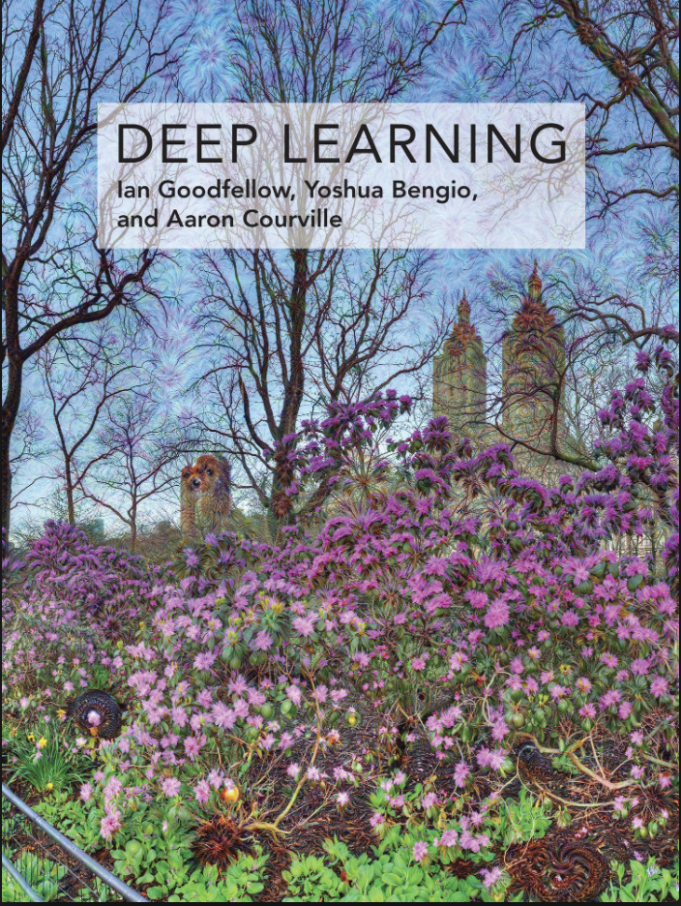


Books and Reading
Recommended textbook: “Deep learning”
by Goodfellow, Bengio, Courville
https://www.deeplearningbook.org/
Another recommended textbook: “Dive into Deep Learning” - https://d2l.ai/
Lots of further material available online, e.g.:
http://cs231n.stanford.edu/ http://course.fast.ai/
https://developers.google.com/machine-learning/crash-course/
www.nvidia.com/dlilabs http://introtodeeplearning.com/
https://github.com/oxford-cs-deepnlp-2017/lectures,
https://jalammar.github.io/
Coursera, Youtube, etc.
“Deep Learning with Python” by François Chollet
for labs + assignments

Slide 4
Course Schedule & Content
DATE | Overview | Lecture Details | Scope
Week 1 | Introduction - Course Structure, Logistics, Fundamentals of Machine Learning and Neural Networks | 1. Introduction to Neural Network, Multilayer Perceptron, Back Propagation Learning - What is Deep Learning? | BASICS
Week 2 | Fundamentals of Learning | 2. Introduction to Deep Learning, Bayesian Learning, Hebbian Learning, Decision Surfaces, Representation Learning. 3. Theory of Deep Learning (Universal approximation theorem, convergence rate, and recent mathematical results)
Week 3 | Mathematics & Fundamentals of Deep Learning | 4. Linear Classifiers, Linear Machines with Hinge Loss, Gradient Descent, Activation and Loss Functions. 5. Optimization Techniques, Gradient Descent, Batch Optimization, Introduction to Meta-Learning, Hessian-Free Optimization.
Week 4 | Deep Neural Networks | Deep Neural Networks: Features, Feature Representation, Representation Learning, BoFs/BoWs, Feature Maps, Deep vs. Shallow Nets | FUNDAMENTALS OF DEEP (CONVOLUTIONAL) LEARNING
Week 5 | Convolutional Neural Networks | 6. Convolutional Neural Networks, Building blocks of CNN | DEEP NEURAL NETWORKS - DEEP INTO DEEP LEARNING
Week 6 | Deep Convolutional Neural Networks | Pooling, Convolutional, Softmax Layers
Week 7 | Deep Convolutional Neural Networks | Optimizing ConvNets, Transfer Learning, Residual Networks
Week 8 | Deep Learning Optimization | 11. Deep Learning Model Optimization; Early Stopping/Exit, Dropout, Batch Normalization, Instance Normalization, Group Normalization, Pruning, Quantization, Hyperparameter Optimization.
Week 9 | Recurrent Neural Networks, Transformers | RNNs, LSTMs
Week 10 | Transformers, Attention | Attention Mechanisms and Transformer Networks | EMERGING DEEP LEARNING RESEARCH AND APPLICATIONS
Week 11 | Generative Adversarial Networks | Unsupervised Learning with Deep Network, Autoencoders Cont’d, 8. Generative Adversarial Networks, Adversarial Learning Models, Variational Autoencoders
Week 12 | Deep Reinforcement Learning - Graph Neural Networks | Deep Reinforcement Learning (Q-learning, actor-critic, policy gradient, experience replay, double Q-learning, deep bootstrap networks).
Week 13 | Graph Neural Networks and Deep Learning Trends | Graph Neural Networks – Graph Signal Processing, Convolutional Networks on Graphs, Gated Graph Sequence Networks, Semi-Supervised Graph Convolutional Networks Interpretable Deep Neural Networks DNNs for Vision and NLP - GPTS/LLMS
Exam Period | Final Exam | Comprehensive Final Exam | EVALUATION

Slide 5
Convolutional Neural Networks
Current State of the Art for Multidimensional Data Representation Recognition

Slide 6
Convolutional Neural Networks¹
  Convolutional Neural Networks (CNNs) are neural networks that use convolution in place of general matrix multiplication in at least one of their layers
  they are usually employed for processing data that has a grid-like topology
    image data → each image can be thought as a 2D grid of pixels
    timeseries data → each timeseries can be thought as a 1D grid taking samples at regular time intervals

Slide 7
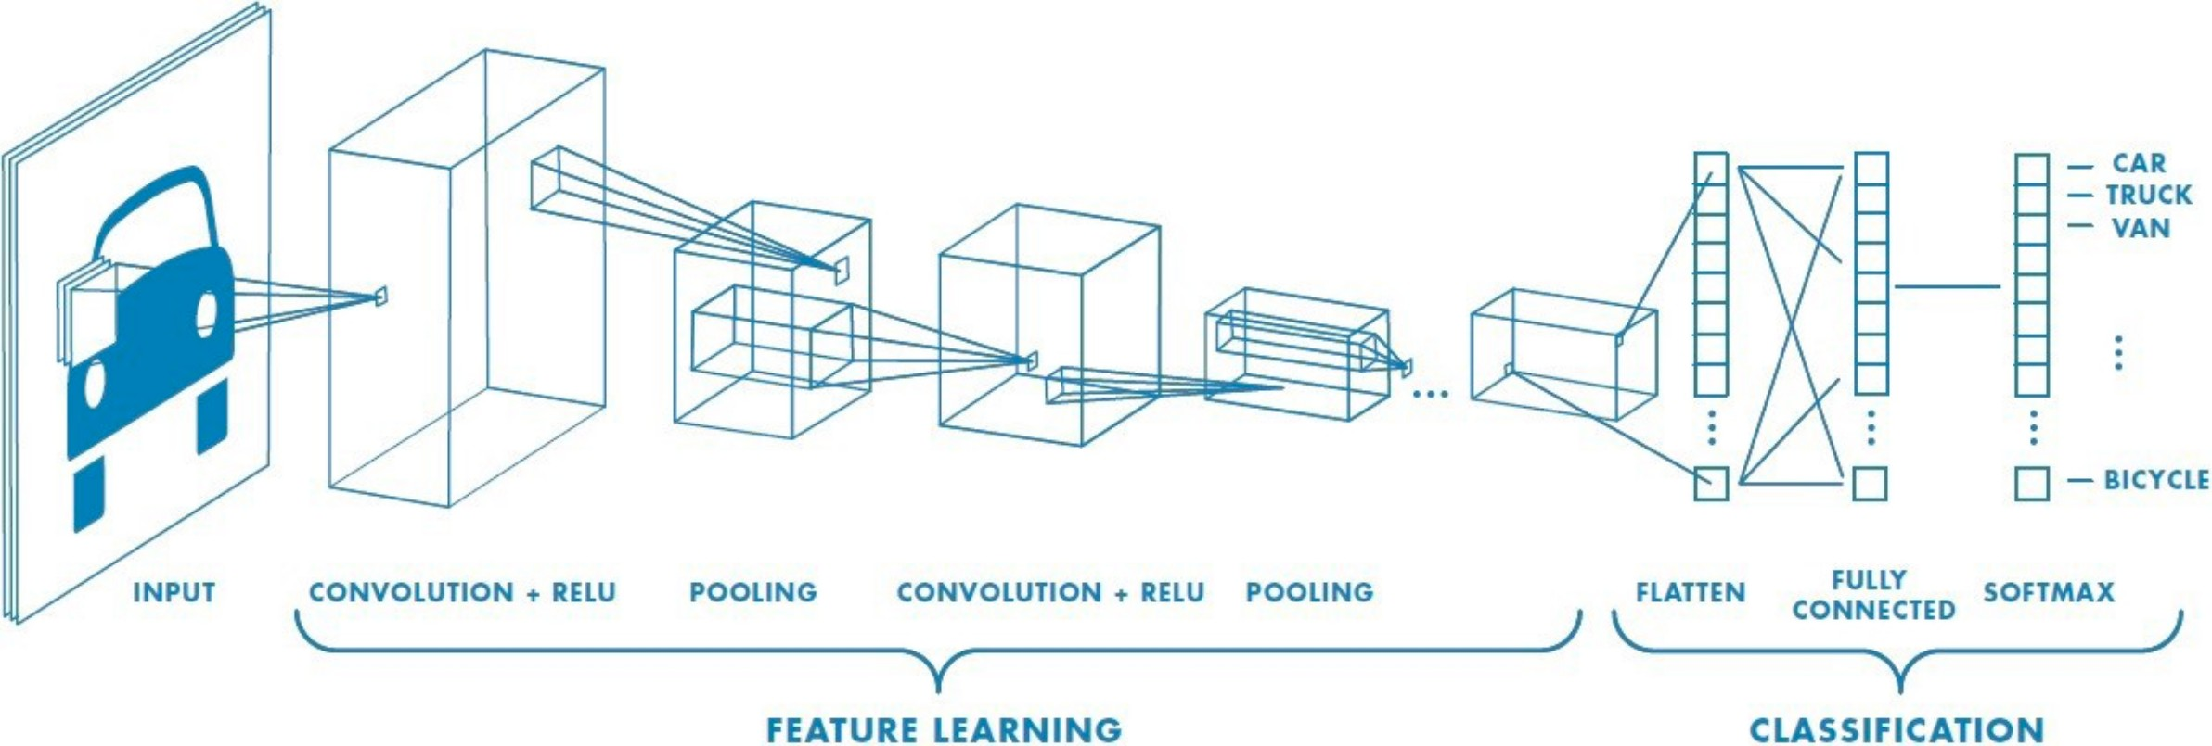
CNN - Neural Network with a Convolutional Layer
CNNs are simply neural networks that use convolution in place of general matrix multiplication in at least one of their layers
Convolution can be viewed as multiplication by a matrix

Slide 8
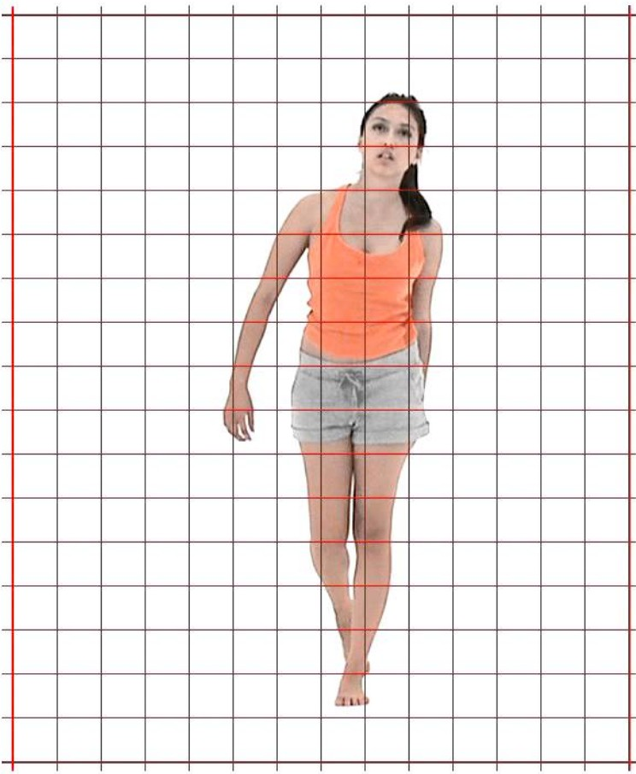
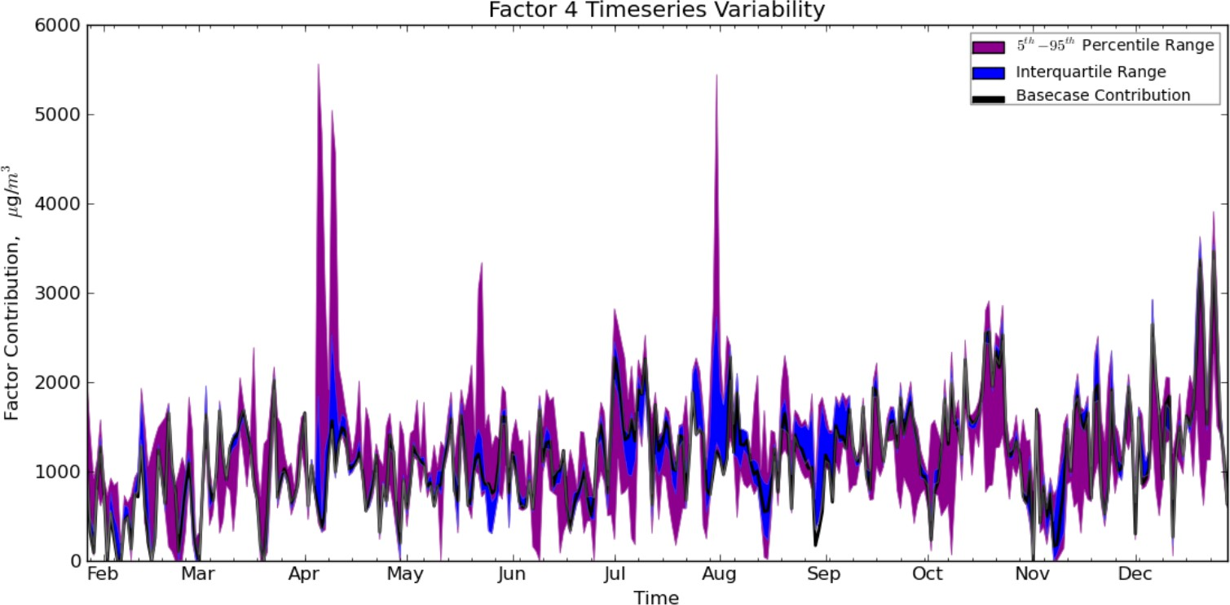
Overview of Convolutional Networks
Convolutional networks, also known as Convolutional neural networks, CNNs, or ConvNets are a specialized kind of neural network
Used for processing data that has a known grid-like topology
  Ex: time-series data, which is a 1-D grid, taking samples at intervals
Image data, which are 2-D grid of pixels
Utilize convolution, which is a specialized kind of linear operation

Slide 9
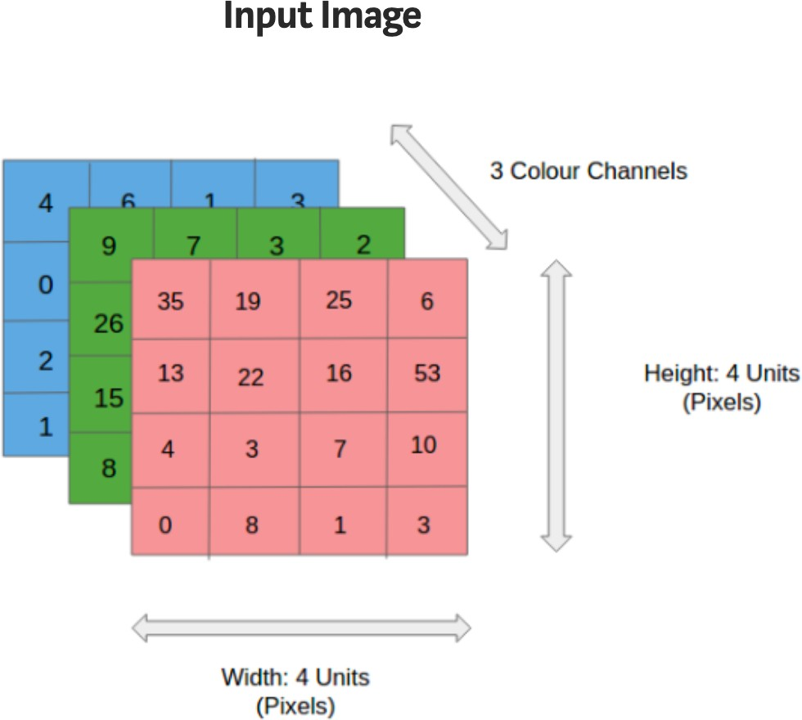
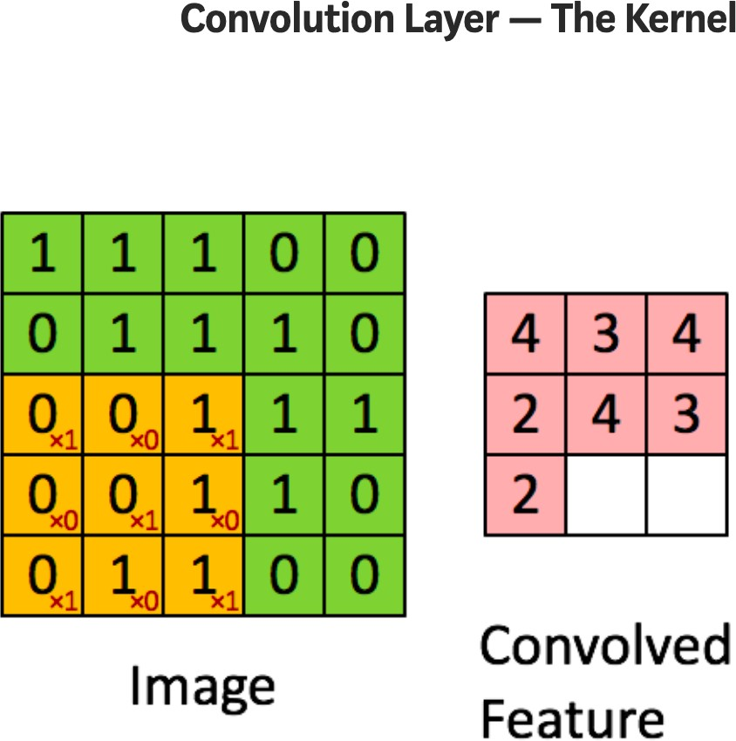
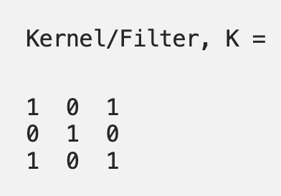
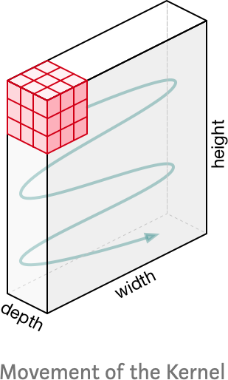
Convolutional Layer for Image Recognition

Slide 10
What is Convolution?
Convolution is an operation on two functions of a real-valued argument and can be considered an averaging process
Examples of the two functions in one dimension
  Tracking location of a spaceship by a laser sensor
    A laser sensor provides a single output x(t), the position of spaceship at time t
  w a function of a real-valued argument
    If laser sensor is noisy, we want a weighted average that gives more weight to recent observations
    Weighting function is w(a) where a is age of a measurement
Convolution is the weighted average or smoothed estimate of the position of the spaceship
A new function s
s(t) = ∫ x(a)w(t −a)da

Slide 11
What is a convolution?
The fundamental operation, the convolution I * K(I,j) = \sum \sum
Flipping kernels makes the convolution commutative, which is fundamental in theory, but not required in NN to compose with other functions, so to include discrete correlations as well into “convolution”
Convolution is a linear operator, dot-product like correlation, not a matrix multiplication, but can be implemented as a sparse matrix multiplication, to be viewed as an affine transform

Slide 12
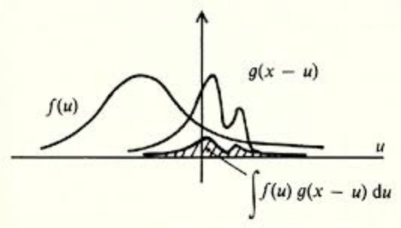
Definition of Convolution of Input and Kernel
Convolution function s is a weighted average of x
s(t) = ∫ x(a)w(t −a)da
This operation is typically denoted with an asterisk
Convolution of f(u) and g(u)
s(t) = (x * w)(t)
w needs to be a valid probability density function, or the output is not a weighted average
w needs to be 0 for negative arguments, or we will look into the future
In convolution network terminology the first function x is referred to as the input, the second function w is referred to as the kernel
The output s is referred to as the feature map
Properties:
Commutative
Associative
Distributive

Slide 13
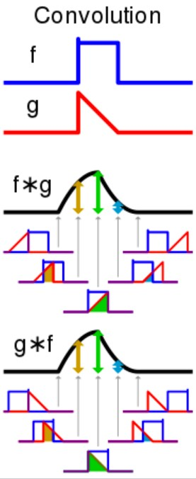
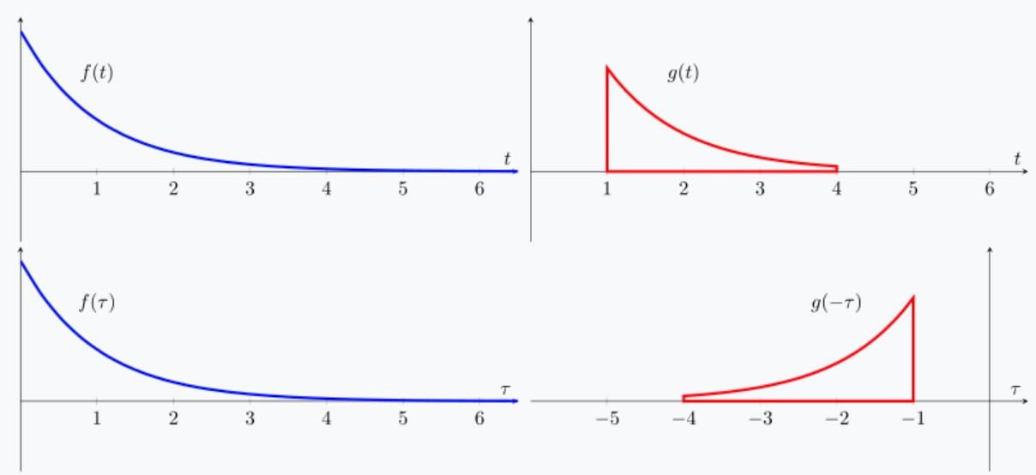
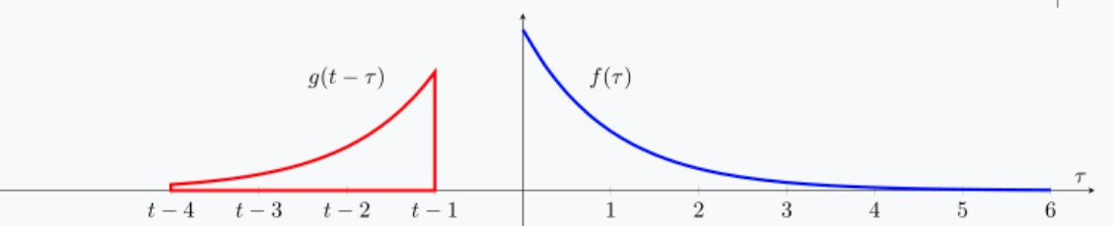
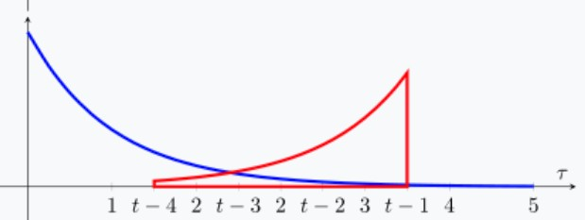
Performing 1-D Convolution
One-dimensional continuous case
  Input f(t) is convolved with a kernel g(t)
(f * g) ≡ ∫ f (τ)g(t − τ)dτ
−∞
∞
Note that (f * g )=(g * f )
Express each function in terms of a dummy variable τ
Reflect one of the functions g(τ)→g(-τ)
Add a time offset t, which allows g(t-τ) to slide along the τ axis
4. Start t at -∞ and slide
all the way to +∞
Wherever the two functions intersect find the integral of their product

Slide 14
Convolution with Discrete Variables
Ex: Laser sensor may only provide data at regular intervals
Time index t takes on only integer values
  x and w are defined only on integer t
s(t) = (x * w)(t) = ∑ x(a)w(t −a)
a=−∞
∞
In ML applications, input is a multidimensional array of data and the kernel is a multidimensional array of parameters that are adapted by the learning algorithm
  These arrays are referred to as tensors
Input and kernel are explicitly stored separately
  The functions are zero everywhere except at these points

Slide 15


Convolution in Discrete Case
Here we have discrete functions f and g
(f * g)[t ] = ∑ f [τ]⋅ g[t − τ]
τ=−∞
∞
f [t ]
g [t-τ ]

Slide 16
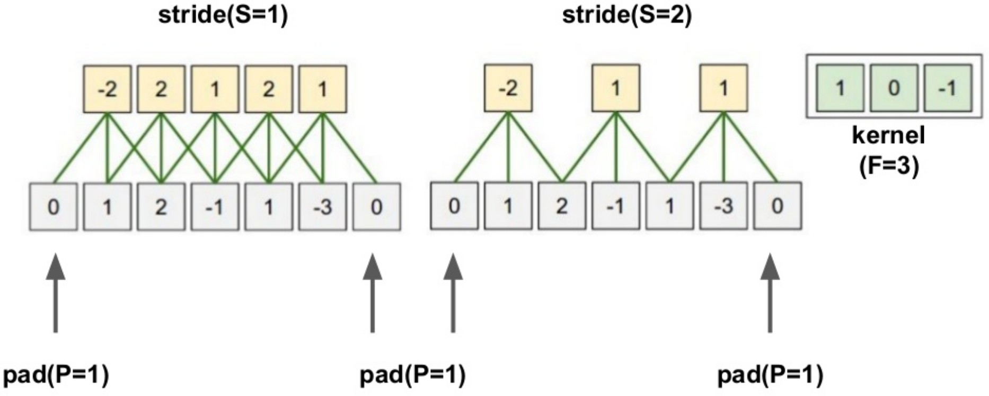
Computation of 1-D Discrete Convolution
Parameters of convolution:
Kernel size (F) Padding (P) Stride (S)
(f *g)[t]
g[t-τ]
f [t]

Slide 17
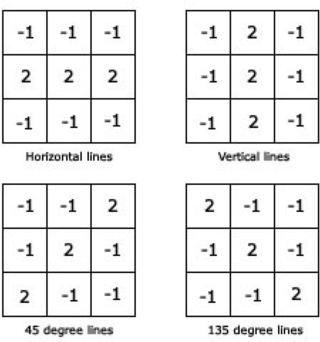
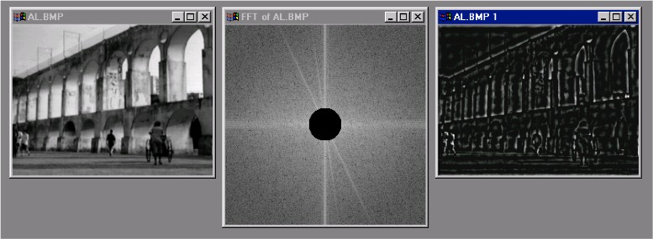
Two-Dimensional Convolution
Convolutions over more than one axis
For a 2D image I as input and a 2D kernel K we have
S(i, j) = (I * K )(i, j) = ∑∑I(m,n)K(i − m, j − n)
m n
Kernels K₁-K₄ for line detection
Sharply peaked kernel K for edge detection
I(i , j) K(i , j) S(i , j)

Slide 18
Commutativity of Convolution
Convolution is commutative. We can equivalently write:
S(i, j) = (K * I )(i, j) = ∑∑I(i − m, j − n)K(m,n)
m n
This formula is easier to implement in a ML library since there is less variation in the range of valid values of m and n
Commutativity arises because we have flipped the kernel relative to the input
  As m increases, index to the input increases, but index to the kernel decreases

Slide 19
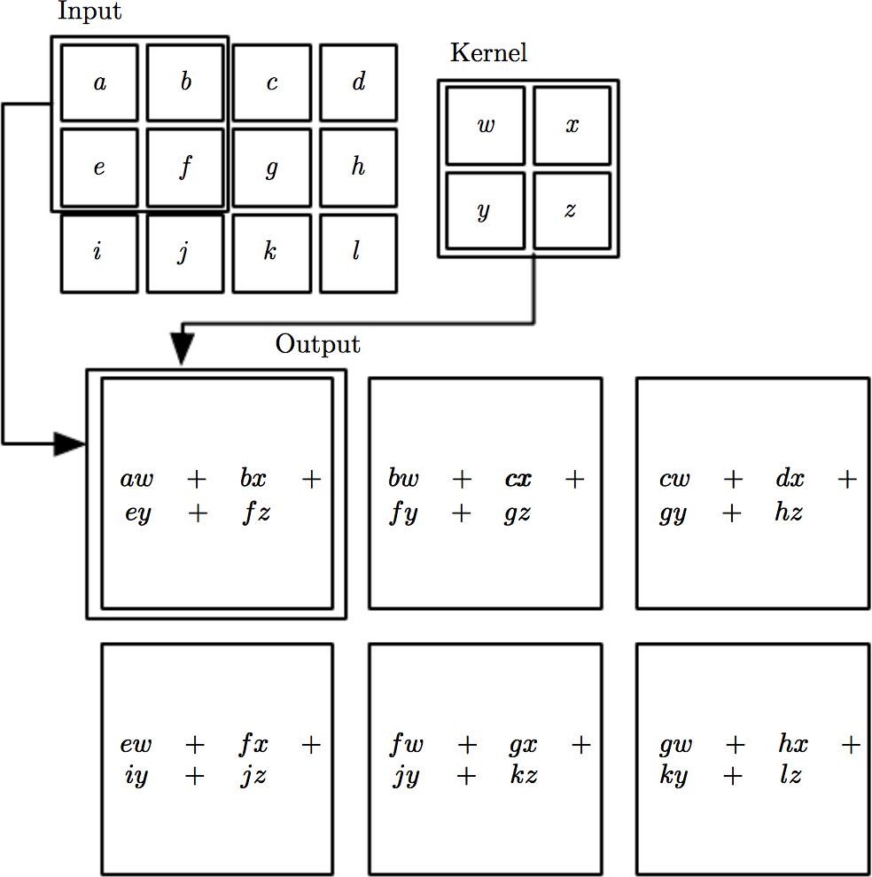
Example of 2D convolution
Convolution without kernel flipping applied to a 2D tensor
Output is restricted to case where kernel is situated entirely within the image
Arrows show how upper- left of input tensor is used to form upper-left of output tensor

Slide 20
Overview of Convolutional Networks
Convolutional networks, also known as Convolutional neural networks (CNNs or ConvNet) are a specialized kind of neural network
Used for processing data that has a known grid-like topology
  Time-series data, which is a 1-D grid, taking samples at intervals
  Image data, which are 2-D grid of pixels
Utilize convolution as a specialized kind of linear operation
The convolution operation is used in place of a general matrix multiplication in at least one layer

Slide 21
Motivation for Using Convolution Networks
Convolution leverages three important ideas to improve ML systems:
  Sparse interactions
  Parameter sharing
  Equivariant representations
Convolution also allows for working with inputs of variable size

Slide 22
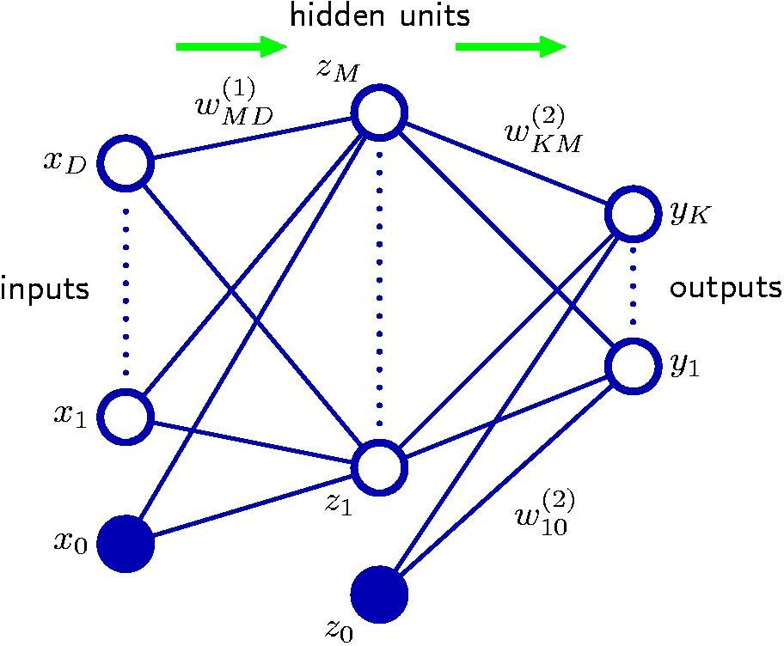
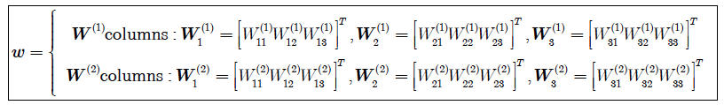
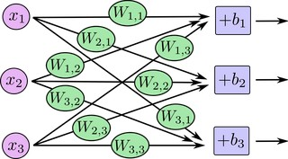


Neural Net Matrix Multiplication
Each layer produces values that are obtained from previous layer by performing a matrix-multiplication
In an unaugmented network
  Hidden layer produces values z =h (W^{(1)T} x + b⁽¹⁾)
  Output layer produces values y =σ(W^{(2)T} x + b⁽²⁾)
Note:W⁽¹⁾ and W⁽²⁾ are matrices rather than vectors
Augmented network
Example with D=3, M=3
x=[x₁,x₂,x₃]^{T}
We have two weight matrices W⁽¹⁾ and W⁽²⁾
First Network layer
Network layer output
In matrix multiplication notation

Slide 23

Matrix Multiplication for 2D Convolution
Far fewer weights needed than full matrix multiplication!

Slide 24
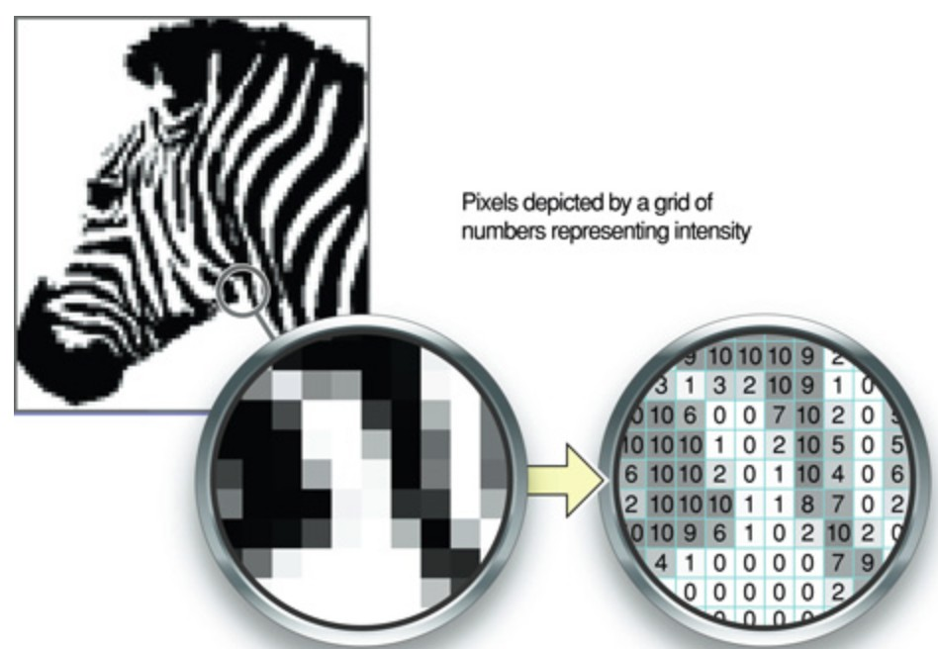
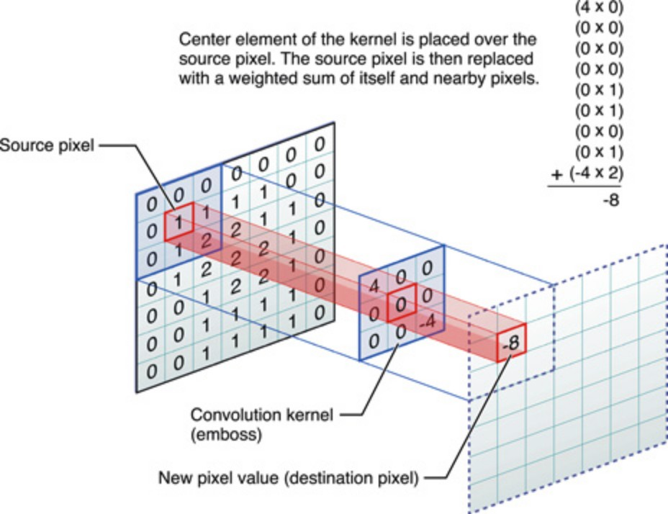
Sparse Connectivity Due to Image Convolution
Input image may have millions of pixels,
But we can detect edges with kernels of
hundreds of pixels
If limit number of connections for each input n to k
  now need kxn parameters and O(k×n)
runtime
It is possible to get good performance with k<<n
Convolutional networks have sparse interactions
Accomplished by making the kernel smaller than the input Next slide shows graphical depiction
5

Slide 25
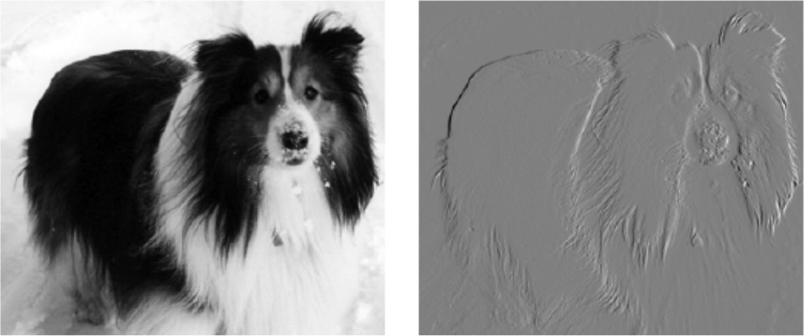
Efficiency of Convolution for Edge Detection
Image on right formed by taking each pixel of input image and subtracting the value of its neighboring pixel on the left
  This is a measure of all the vertically oriented edges in input image which is useful for object detection
Input image
Both images are 280 pixels tall Input image is 320 pixels wide Output image is 319 pixels wide
Transformation can be described by a convolution kernel containing two elements and requires 319×320×3=267,960 flops (2 multiplies, one add)
Same transformation would require 320×280×319×280,
i.e., 8 billion entries in the matrix
Convolution is 4 billion times more efficient

Slide 26
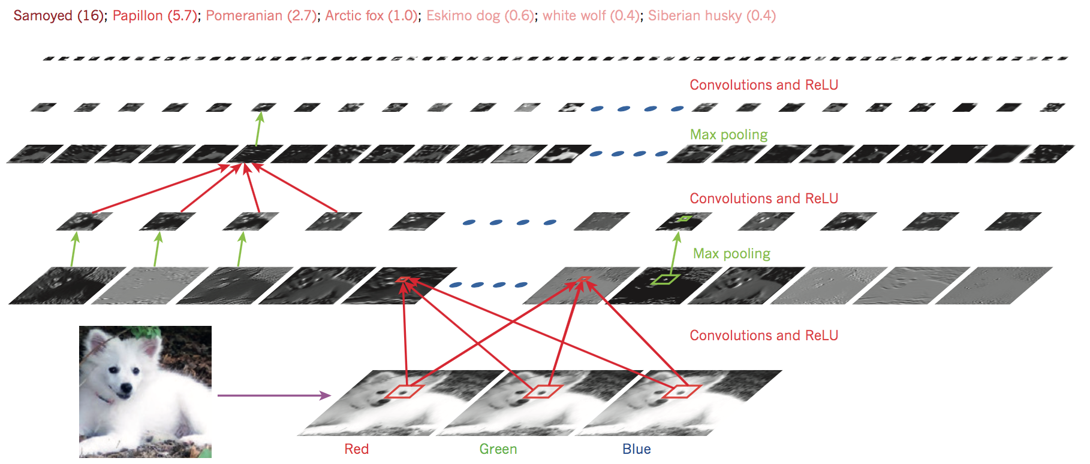
Convolutional Neural Network (CNN)
Convolutional Neural Networks, or Convolutional Networks, or CNNs, or ConvNets
For processing data with a grid-like or array topology
  1-D grid: time-series data, sensor signal data
  2-D grid: image data
  3-D grid: video data
CNNs include four key ideas
related to natural signals:
  Local connections
  Shared weights
  Pooling
  Use of many layers

Slide 27
Convolutional Neural Network (CNN)
Convolutional Neural Networks are inspired by mammalian visual cortex.
  The visual cortex contains a complex arrangement of cells, which are sensitive to small sub-regions of the visual field, called a receptive field.
  These cells act as local filters over the input space and are well-suited to exploit the strong spatially local correlation present in natural images.
  Two basic cell types:
    Simple cells respond maximally to specific edge-like patterns within their receptive field.
    Complex cells have larger receptive fields and are locally invariant to the exact position of the pattern.

Slide 28
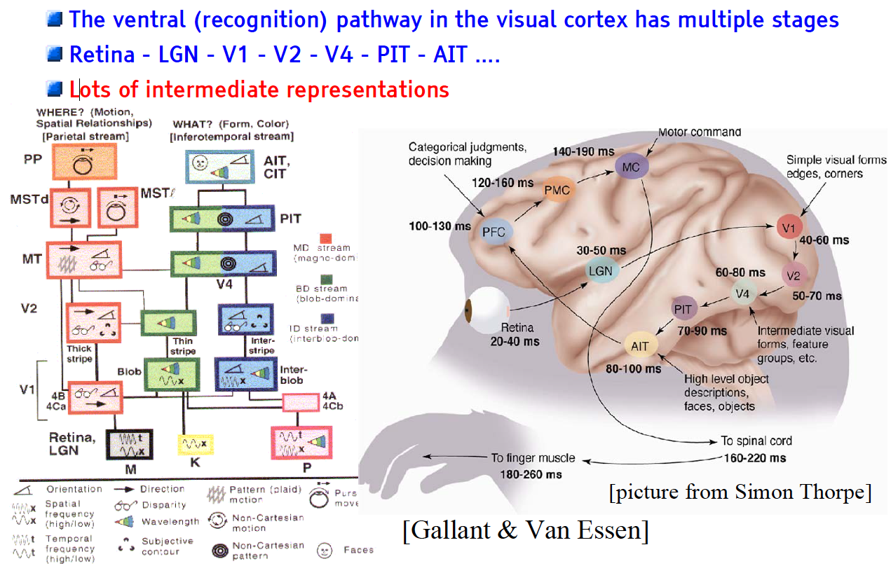
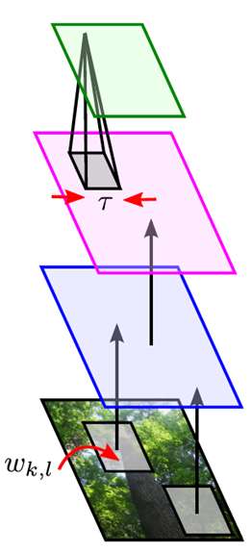
The Mammalian Visual Cortex Inspires CNN
Convolutional Neural Net
output
input

Slide 29
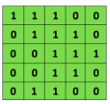
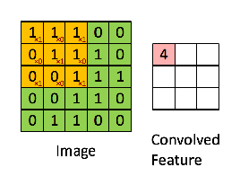

Convolutional Neural Networks (CNNs)
Convolutional Neural Networks
Convolutional neural networks (CNNs) were primarily designed for image data
CNNs use a convolutional operator for extracting data features
  Allows parameter sharing
  Efficient to train
  Have less parameters than NNs with fully-connected layers
CNNs are robust to spatial translations of objects in images
A convolutional filter slides (i.e., convolves) across the image
Convolutional
3x3 filter
Input matrix
Picture from: http://deeplearning.stanford.edu/wiki/index.php/Feature_extraction_using_convolution

Slide 30
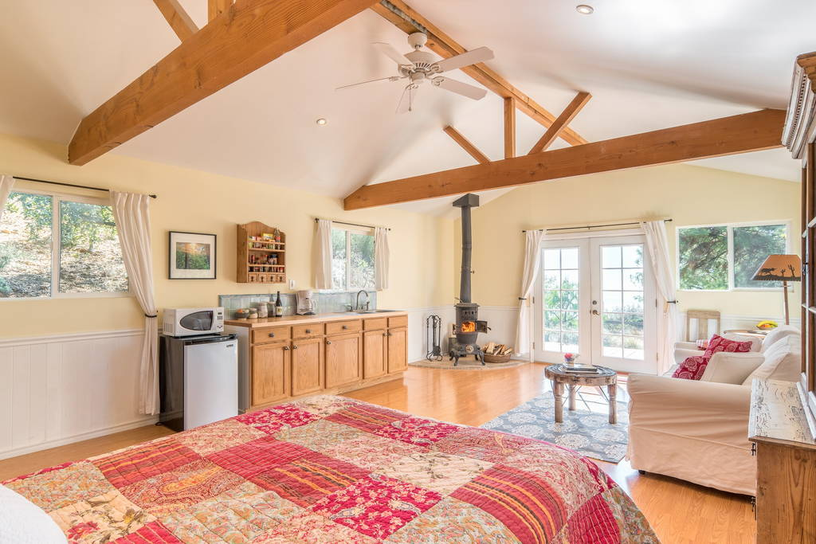
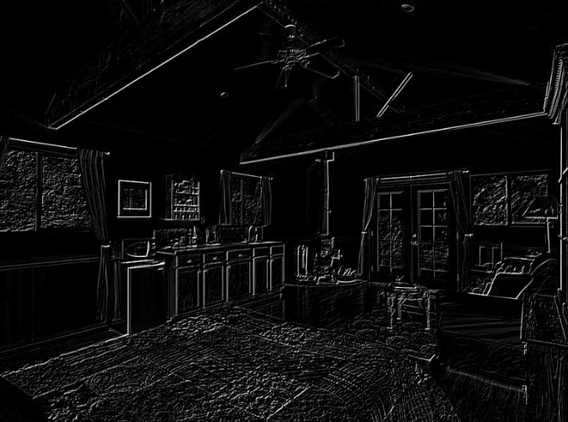
Convolutional Neural Networks (CNNs)
Convolutional Neural Networks
When the convolutional filters are scanned over the image, they capture useful features
  E.g., edge detection by convolutions
0 1 0
1 -4 1
0 1 0
Filter
Input Image
Convoluted Image
Slide credit: Param Vir Singh – Deep Learning

Slide 31
Convolutional Neural Networks (CNNs)
Convolutional Neural Networks
In CNNs, hidden units in a layer are only connected to a small region of the layer before it (called local receptive field)
  The depth of each feature map corresponds to the number of convolutional filters used at each layer
w1 | w2
w3 | w4
w5 | w6
w7 | w8
Filter 1
Filter 2
Input Image
Layer 1 Feature Map
Layer 2 Feature Map
Slide credit: Param Vir Singh – Deep Learning

Slide 32
Convolutional Neural Networks (CNNs)
Convolutional Neural Networks
Max pooling: reports the maximum output within a rectangular neighborhood
Average pooling: reports the average output of a rectangular neighborhood
Pooling layers reduce the spatial size of the feature maps
  Reduce the number of parameters, prevent overfitting
MaxPool with a 2×2 filter with stride of 2
1 | 3 | 5 | 3
4 | 2 | 3 | 1
3 | 1 | 1 | 3
0 | 1 | 0 | 4
4 | 5
3 | 4
Output Matrix
Input Matrix
Slide credit: Param Vir Singh – Deep Learning

Slide 33

Convolutional Neural Networks (CNNs)
Convolutional Neural Networks
Feature extraction architecture
  After 2 convolutional layers, a max-pooling layer reduces the size of the feature maps (typically by 2)
  A fully convolutional and a softmax layers are added last to perform classification
Living Room
Bedroom
64
64
128
128
256
256
256
512
512
512
512
512
512
Kitchen
Bathroom
Conv layer
Max Pool
Outdoor
Fully Connected Layer
Slide credit: Param Vir Singh – Deep Learning

Slide 34
From a regular network to CNN
We have regarded an input image as a vector of features, x, by virtue of feature detection and selection, like other machine learning applications to learn f(x)
We now regard it as is, a 2D image, a 2D grid, a topological discrete lattice, I(I,j)
Converting input images into feature vector loses the spatial neighborhood-ness
complexity increases to cubics
Yet, the connectivities become local to reduce the complexity!

Slide 35
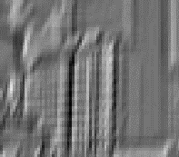
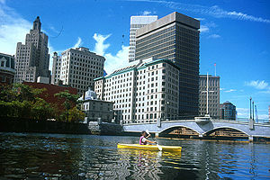
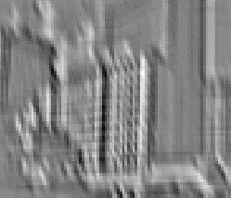


What is a Convolution?
Weighted moving sum
...
Input
Feature Activation Map
slide credit: S. Lazebnik

Slide 36
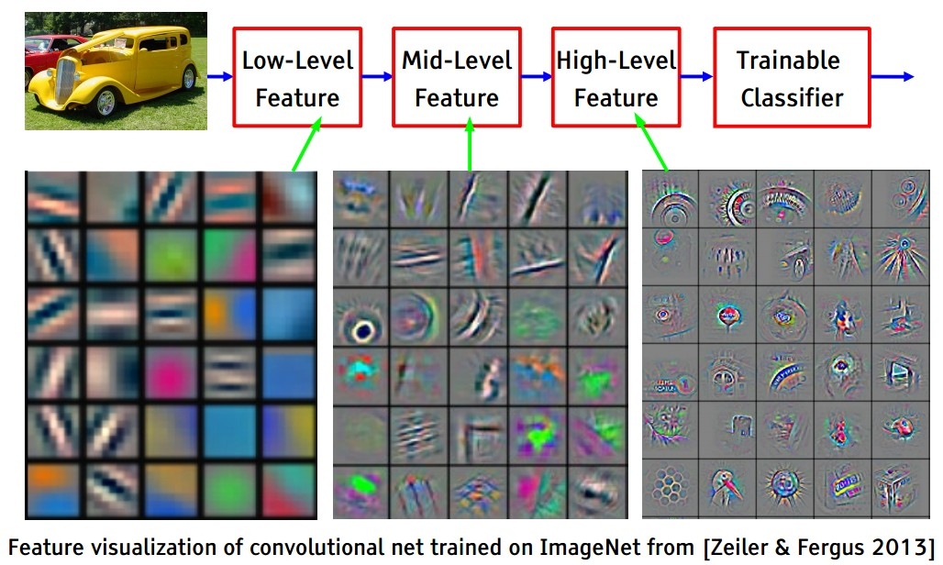
A Deep Classification Network

Slide 37
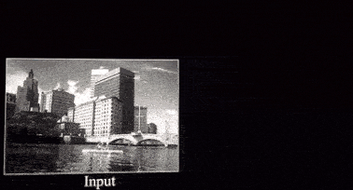
Each filter searches for a particular feature at different image locations (translation invariance)

Slide 38
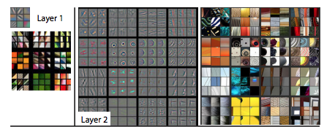
Features at successive convolutional layers
+/- 45 degree
edges in Layer 1
Corners and other edge color conjunctions in Layer 2
Visualizing and Understanding Convolutional Networks,
Matthew D. Zeiler and Rob Fergus, ECCV 2014

Slide 39
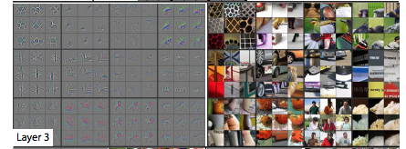
Features at successive convolutional layers
More complex invariances than Layer 2. Similar textures e.g. mesh patterns (R1C1); Text (R2C4).
Visualizing and Understanding Convolutional Networks,
Matthew D. Zeiler and Rob Fergus, ECCV 2014

Slide 40
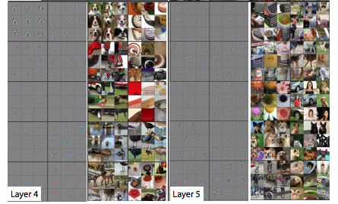
Features at successive convolutional layers
Significant variation, more class specific.
Dog faces (R1C1); Bird legs (R4C2).
Entire objects with significant pose variation.
Keyboards (R1C1); dogs (R4).
Visualizing and Understanding Convolutional Networks,
Matthew D. Zeiler and Rob Fergus, ECCV 2014

Slide 41
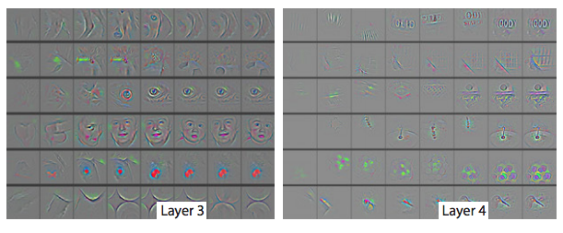
Who decides these features?
The network itself while training learns the filter weights and bias terms.
Evolution of randomly chosen subset of model features at training epochs 1,2,5,10,20,30,40,64.
Visualizing and Understanding Convolutional Networks,
Matthew D. Zeiler and Rob Fergus, ECCV 2014

Slide 42
CNN Architecture
Intuition: Neural network with specialized connectivity structure
  Stacking multiple layers of feature extractors, low-level layers extract local features, and high-level layers extract learn global patterns.
There are a few distinct types of layers:
  Convolutional Layer: detecting local features through filters (discrete convolution)
  Non-linear Layer: normalization via Rectified Linear Unit (ReLU)
  Pooling Layer: merging similar features

Slide 43
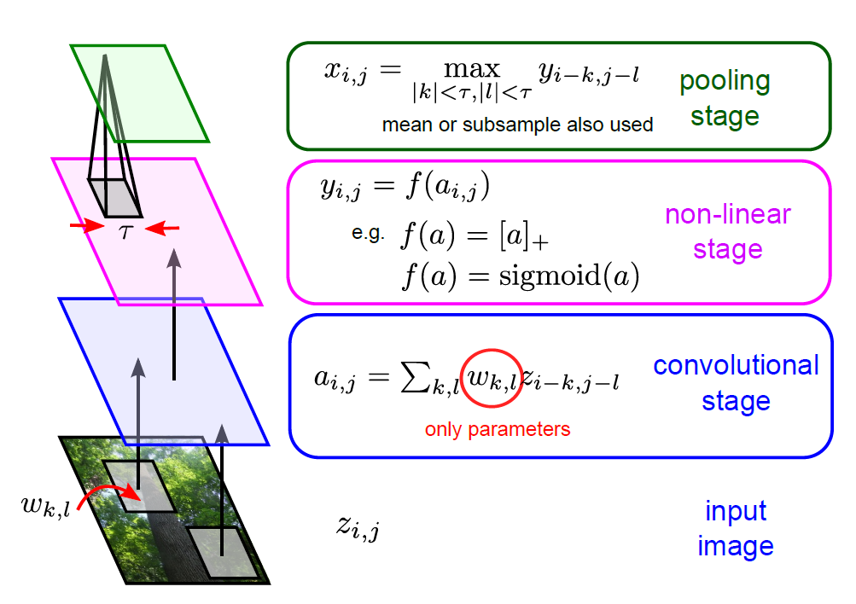
Building-blocks for CNNs
Feature maps of a larger region are combined.
Feature maps are trained with neurons and weights.
Shared weights
Each sub-region yields a feature map, representing its feature.
Images are segmented into sub-regions.

Slide 44
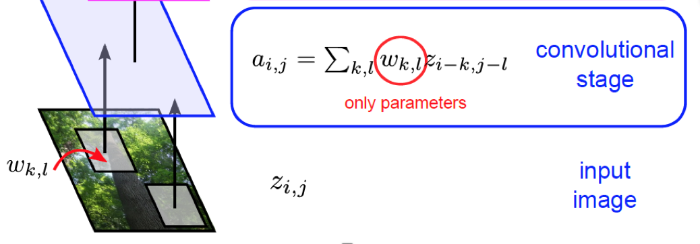
(1) Convolutional Layer
The core layer of CNNs
Convolutional layer consists of a set of filters, w_{k,l}
  Each filter covers a spatially small portion of the input data, Z_{i,j}
Each filter is convolved across the dimensions of the input data, producing a multidimensional feature map.
  As we convolve the filter, we are computing the dot product between the parameters of the filter and the input.
Deep Learning algorithm: During training, the network corrects errors and filters are learned by adjusting weights based on Stochastic Gradient Descent, SGD (stochastic approximation of GD using a randomly selected subset of the data).
The key architectural characteristics of the convolutional layer is local connectivity and shared weights.

Slide 45
Convolutional Layer: Local Connectivity
Neurons in layer m are only connected to 3 adjacent neurons in the m-1 layer.
Neurons in layer m+1 have a similar connectivity with the layer below.
Each neuron is unresponsive to variations outside of its receptive field with respect to the input.
  Receptive field: small neuron collections which process portions of the input data
The architecture thus ensures that the learnt feature extractors produce the strongest response to a spatially local input pattern.

Slide 46
Convolutional Layer: Shared Weights
We show 3 hidden neurons belonging to the same feature map (the layer right above the input layer).
Weights of the same color are shared—constrained to be identical.
Replicating neurons in this way allows for features to be detected regardless of their position in the input.
Additionally, weight sharing increases learning efficiency by greatly reducing the number of free parameters being learnt.

Slide 47
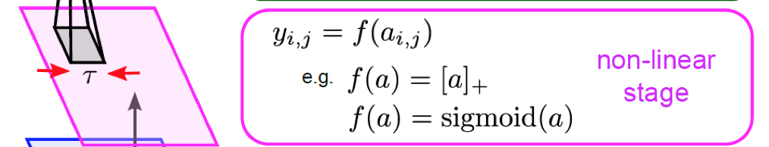
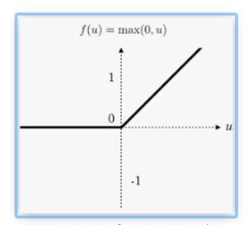
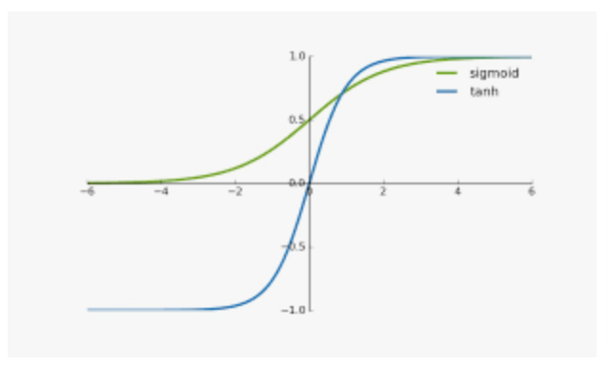
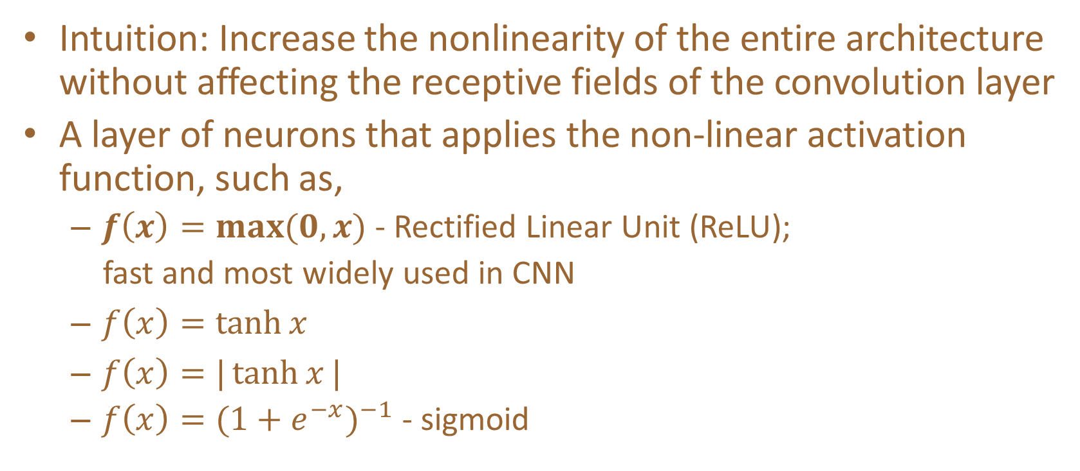
(2) Non-linear Layer
Intuition: Increase the nonlinearity of the entire architecture without affecting the receptive fields of the convolution layer
A layer of neurons that applies the non-linear activation function, such as,
  $f\left(x\right)=\max{(0,x)}$ - Rectified Linear Unit (ReLU);
  fast and most widely used in CNN
  $f\left(x\right)=\tanh{x}$
  $f\left(x\right)=|\tanh{x}|$
  $f\left(x\right)={(1+e^{−x})}^{−1}$ - sigmoid

Slide 48
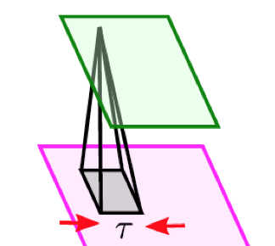
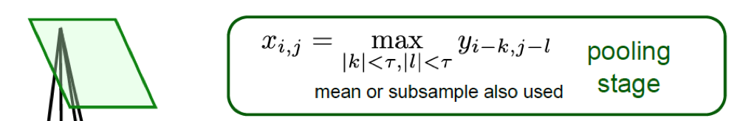
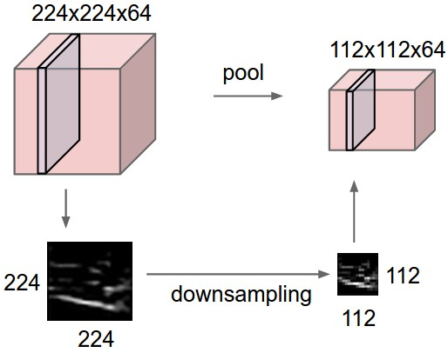
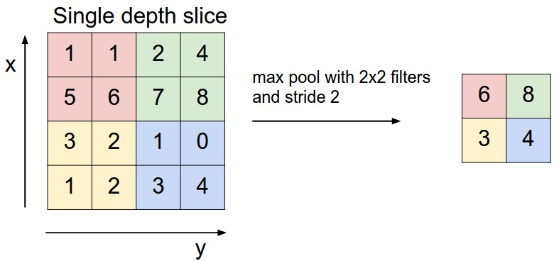
(3) Pooling Layer
Intuition: to progressively reduce the spatial size of the representation to reduce the amount of parameters and computation in the network, and hence to also control overfitting
Pooling partitions the input image into a set of non-overlapping rectangles and, for each such sub-region, outputs the maximum value of the features in that region.
Input

Slide 49
Building-blocks for CNNs
Feature maps of a larger region are combined.
Feature maps are trained with neurons and weights.
Shared weights
Each sub-region yields a feature map, representing its feature.
Images are segmented into sub-regions.

Slide 50
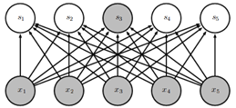
Other Layers
The convolution, non-linear, and pooling layers are typically used as a set. Multiple sets of the above three layers can appear in a CNN design.
  Input -> Conv. -> Non-linear -> Pooling -> Conv. -> Non-linear -> Pooling -> …-> Output
Recent CNN architectures have 10-20 such layers.
After a few sets, the output is typically sent to one or two fully connected layers.
  A fully connected layer is a ordinary
  neural network layer as in other neural networks.
  Typical activation function is the sigmoid function.
  Output is typically class (classification)
  or real number (regression).

Slide 51

Other Layers
The final layer of a CNN is determined by the research task.
Classification: Softmax Layer
  $$P\left(y=j | x\right)=\frac{e^{w_{j}⋅x}}{\sum_{k=1}^{K}{e^{w_{k}⋅x}}}$$
  The outputs are the probabilities of belonging to each class.
Regression: Linear Layer
  $$f\left(x\right)=w⋅x$$
  The output is a real number.

Slide 52

Full CNN: from Input to Output
pooling
pooling

Slide 53

Discrete convolution
A discrete convolution is a linear transformation
  Sparse – only few inputs contribute to a given output unit
  Reuses parameters – same kernel is applied over multiple input elements
 | x0 | x1 | x2
 | x3 | x4 | x5
 | x6 | x7 | x8
k0 | k1 | k2
k3 | k4 | k5
k6 | k7 | k8
 | y4
*
=
Input
Kernel
Output
Figure: In this example, each output element is computed using 9 pixels
Figure: Kernel strides over input

Slide 54
The spatial hyperparameters
Depth
Stride
Zero-padding

Slide 55

Convolution Layer
Figure: In this example, 5x5 input is convolved with 3x3 kernel with stride=padding=1 to produce an output of size 5x5.
Figure: In this example, 5x5 input is convolved with 3x3 kernel with stride=2 and padding=1 to produce an output of size 3x3.
Notes:
Strided convolution can be used for down-sampling

Slide 56

Convolutional Layer
Slide Credit: Marc'Aurelio Ranzato

Slide 57

Convolutional Layer
Slide Credit: Marc'Aurelio Ranzato

Slide 58

Convolutional Layer
Slide Credit: Marc'Aurelio Ranzato

Slide 59

Convolutional Layer
Slide Credit: Marc'Aurelio Ranzato

Slide 60

Convolutional Layer
Slide Credit: Marc'Aurelio Ranzato

Slide 61

Convolutional Layer
Slide Credit: Marc'Aurelio Ranzato

Slide 62

Convolutional Layer
Slide Credit: Marc'Aurelio Ranzato

Slide 63

Convolutional Layer
Slide Credit: Marc'Aurelio Ranzato

Slide 64

Convolutional Layer
Slide Credit: Marc'Aurelio Ranzato

Slide 65

Convolutional Layer
Slide Credit: Marc'Aurelio Ranzato

Slide 66

Convolutional Layer
Slide Credit: Marc'Aurelio Ranzato

Slide 67

Convolutional Layer
Slide Credit: Marc'Aurelio Ranzato

Slide 68

Convolutional Layer
Slide Credit: Marc'Aurelio Ranzato

Slide 69

Convolutional Layer
Slide Credit: Marc'Aurelio Ranzato

Slide 70

Convolutional Layer
Slide Credit: Marc'Aurelio Ranzato

Slide 71

Convolutional Layer
Mathieu et al. “Fast training of CNNs through FFTs” ICLR 2014
Slide Credit: Marc'Aurelio Ranzato

Slide 72


Convolutional Layer
-1 0 1
-1 0 1
-1 0 1
=
*
Slide Credit: Marc'Aurelio Ranzato

Slide 73

Convolutional Layer
Learn multiple filters.
E.g.: 200x200 image
100 Filters
Filter size: 10x10
10K parameters
Slide Credit: Marc'Aurelio Ranzato

Slide 74
Convolution Layer
32x32x3 image -> preserve spatial structure
32
height
32
width
3
depth
Slide Credit: Fei-Fei Li, Justin Johnson, Serena Yeung, CS 231n
Notes:
Preserve spatial structure of input

Slide 75
Convolution Layer
32x32x3 image
5x5x3 filter
32
Convolve the filter with the image
i.e. “slide over the image spatially, computing dot products”
32
3
Slide Credit: Fei-Fei Li, Justin Johnson, Serena Yeung, CS 231n

Slide 76
Convolution Layer
Filters always extend the full depth of the input volume
32x32x3 image
5x5x3 filter
32
Convolve the filter with the image
i.e. “slide over the image spatially, computing dot products”
32
3
Slide Credit: Fei-Fei Li, Justin Johnson, Serena Yeung, CS 231n

Slide 77


Convolution Layer
32x32x3 image
5x5x3 filter
32
1 number:
the result of taking a dot product between the filter and a small 5x5x3 chunk of the image
(i.e. 5*5*3 = 75-dimensional dot product + bias)
32
3
Slide Credit: Fei-Fei Li, Justin Johnson, Serena Yeung, CS 231n

Slide 78
Convolution Layer
activation map
32x32x3 image
5x5x3 filter
32
28
convolve (slide) over all spatial locations
32
28
3
1
Slide Credit: Fei-Fei Li, Justin Johnson, Serena Yeung, CS 231n

Slide 79
consider a second, green filter
Convolution Layer
32x32x3 image
5x5x3 filter
activation maps
32
28
convolve (slide) over all spatial locations
32
28
3
1
Slide Credit: Fei-Fei Li, Justin Johnson, Serena Yeung, CS 231n

Slide 80
For example, if we had 6 5x5 filters, we’ll get 6 separate activation maps:
activation maps
32
28
Convolution Layer
32
28
3
6
We stack these up to get a “new image” of size 28x28x6!
Slide Credit: Fei-Fei Li, Justin Johnson, Serena Yeung, CS 231n

Slide 81
Preview: ConvNet is a sequence of Convolution Layers, interspersed with activation functions
32
28
CONV,
ReLU
e.g. 6 5x5x3 filters
32
28
3
6
Slide Credit: Fei-Fei Li, Justin Johnson, Serena Yeung, CS 231n

Slide 82
Preview: ConvNet is a sequence of Convolutional Layers, interspersed with activation functions
32
28
24
….
CONV,
ReLU
e.g. 6 5x5x3 filters
CONV,
ReLU
e.g. 10 5x5x6 filters
CONV,
ReLU
32
28
24
3
6
10
Slide Credit: Fei-Fei Li, Justin Johnson, Serena Yeung, CS 231n

Slide 83

Preview
[Zeiler and Fergus 2013]
Visualization of VGG-16 by Lane McIntosh. VGG-16 architecture from [Simonyan and Zisserman 2014].
Slide Credit: Fei-Fei Li, Justin Johnson, Serena Yeung, CS 231n
Notes:
Each layer has many filters each producing an activation map
what ends up learning is hierarchy of filters, talk more in depth later
In this visualization [Lane] maximized the activity of a central cluster of units from the same filter type in various VGG-16 layers by taking image gradients. So not exactly what Zeiler and Fergus did, but somewhat similar.

Slide 84

one filter =>
one activation map
example 5x5 filters
(32 total)
Figure copyright Andrej Karpathy.
Slide Credit: Fei-Fei Li, Justin Johnson, Serena Yeung, CS 231n
Notes:
Here have examples of activation maps produced by each filter
Each filter is slid over input to layer to produce an activation map
Because of sliding, call convolutional
Conv with neg. of filter (cross correlation)

Slide 85


preview:
Slide Credit: Fei-Fei Li, Justin Johnson, Serena Yeung, CS 231n
Notes:
Convnet is stack of layers
Look at how an image progresses through the network, and sizes of output after each layer
Car image is photo taken by Lane McIntosh, permission to use.

Slide 86
A closer look at spatial dimensions:
activation map
32x32x3 image
5x5x3 filter
32
28
convolve (slide) over all spatial locations
32
28
3
1
Slide Credit: Fei-Fei Li, Justin Johnson, Serena Yeung, CS 231n

Slide 87
A closer look at spatial dimensions:
7
7x7 input (spatially)
assume 3x3 filter
7
Slide Credit: Fei-Fei Li, Justin Johnson, Serena Yeung, CS 231n

Slide 88
A closer look at spatial dimensions:
7
7x7 input (spatially)
assume 3x3 filter
7
Slide Credit: Fei-Fei Li, Justin Johnson, Serena Yeung, CS 231n

Slide 89
A closer look at spatial dimensions:
7
7x7 input (spatially)
assume 3x3 filter
7
Slide Credit: Fei-Fei Li, Justin Johnson, Serena Yeung, CS 231n

Slide 90
A closer look at spatial dimensions:
7
7x7 input (spatially)
assume 3x3 filter
7
Slide Credit: Fei-Fei Li, Justin Johnson, Serena Yeung, CS 231n

Slide 91
A closer look at spatial dimensions:
7
7x7 input (spatially)
assume 3x3 filter
=> 5x5 output
7
Slide Credit: Fei-Fei Li, Justin Johnson, Serena Yeung, CS 231n

Slide 92
A closer look at spatial dimensions:
7
7x7 input (spatially)
assume 3x3 filter
applied with stride 2
7
Slide Credit: Fei-Fei Li, Justin Johnson, Serena Yeung, CS 231n

Slide 93
A closer look at spatial dimensions:
7
7x7 input (spatially)
assume 3x3 filter
applied with stride 2
7
Slide Credit: Fei-Fei Li, Justin Johnson, Serena Yeung, CS 231n

Slide 94
A closer look at spatial dimensions:
7
7x7 input (spatially)
assume 3x3 filter
applied with stride 2
=> 3x3 output!
7
Slide Credit: Fei-Fei Li, Justin Johnson, Serena Yeung, CS 231n

Slide 95
A closer look at spatial dimensions:
7
7x7 input (spatially)
assume 3x3 filter
applied with stride 3?
7
Slide Credit: Fei-Fei Li, Justin Johnson, Serena Yeung, CS 231n

Slide 96
A closer look at spatial dimensions:
7
7x7 input (spatially)
assume 3x3 filter
applied with stride 3?
7
doesn’t fit!
cannot apply 3x3 filter on 7x7 input with stride 3.
Slide Credit: Fei-Fei Li, Justin Johnson, Serena Yeung, CS 231n

Slide 97
N
Output size:
(N - F) / stride + 1
e.g. N = 7, F = 3:
stride 1 => (7 - 3)/1 + 1 = 5
stride 2 => (7 - 3)/2 + 1 = 3
stride 3 => (7 - 3)/3 + 1 = 2.33 :\
F
F
N
Slide Credit: Fei-Fei Li, Justin Johnson, Serena Yeung, CS 231n

Slide 98




Convolution without padding
5x5 input. 3x3 filter/kernel/feature detector. 3x3 convolved feature/
activation map/feature map

Slide 99


Convolution with padding
4x4 input. 3x3 filter. Stride = 1.
2x2 output.
5x5 input. 3x3 filter. Stride = 1.
5x5 output.
Animation source: https://github.com/vdumoulin/conv_arithmetic

Slide 100
In practice: Common to zero pad the border
0 | 0 | 0 | 0 | 0 | 0
0
0
0
0
e.g. input 7x7
3x3 filter, applied with stride 1
pad with 1 pixel border => what is the output?
(recall:)
(N - F) / stride + 1
Slide Credit: Fei-Fei Li, Justin Johnson, Serena Yeung, CS 231n

Slide 101
In practice: Common to zero pad the border
0 | 0 | 0 | 0 | 0 | 0
0
0
0
0
e.g. input 7x7
3x3 filter, applied with stride 1
pad with 1 pixel border => what is the output?
7x7 output!
Slide Credit: Fei-Fei Li, Justin Johnson, Serena Yeung, CS 231n

Slide 102
In practice: Common to zero pad the border
0 | 0 | 0 | 0 | 0 | 0
0
0
0
0
e.g. input 7x7
3x3 filter, applied with stride 1
pad with 1 pixel border => what is the output?
7x7 output!
in general, common to see CONV layers with stride 1, filters of size FxF, and zero-padding with (F-1)/2. (will preserve size spatially)
e.g. F = 3 => zero pad with 1
F = 5 => zero pad with 2
F = 7 => zero pad with 3
Slide Credit: Fei-Fei Li, Justin Johnson, Serena Yeung, CS 231n

Slide 103
Convolution Layer
Input
Convolution operator
Output
Kernel
3 | 0 | 3 | 2 | 7 | 4
1 | 5 | 8 | 9 | 3 | 1
2 | 7 | 2 | 5 | 1 | 3
0 | 1 | 3 | 1 | 7 | 8
4 | 2 | 1 | 6 | 2 | 8
2 | 4 | 5 | 2 | 3 | 9
1 | 0 | -1
1 | 0 | -1
1 | 0 | -1
*
=
6 x 6
3 x 3
4 x 4

Slide 104
Convolution Layer
3 | 0 | 3 | 2 | 7 | 4
1 | 5 | 8 | 9 | 3 | 1
2 | 7 | 2 | 5 | 1 | 3
0 | 1 | 3 | 1 | 7 | 8
4 | 2 | 1 | 6 | 2 | 8
2 | 4 | 5 | 2 | 3 | 9
1 | 0 | -1
1 | 0 | -1
1 | 0 | -1
*
=

Slide 105
Convolution Layer
$$3×1+0×0+3×−1+1×1+5×0+8×−1+2×1+7×0+2×−1=−5$$
3 | 0 | 3 | 2 | 7 | 4
1 | 5 | 8 | 9 | 3 | 1
2 | 7 | 2 | 5 | 1 | 3
0 | 1 | 3 | 1 | 7 | 8
4 | 2 | 1 | 6 | 2 | 8
2 | 4 | 5 | 2 | 3 | 9
-5
1 | 0 | -1
1 | 0 | -1
1 | 0 | -1
*
=

Slide 106
Convolution Layer
1 Step
Stride=s=1
3 | 0 | 3 | 2 | 7 | 4
1 | 5 | 8 | 9 | 3 | 1
2 | 7 | 2 | 5 | 1 | 3
0 | 1 | 3 | 1 | 7 | 8
4 | 2 | 1 | 6 | 2 | 8
2 | 4 | 5 | 2 | 3 | 9
-5 | -4
1 | 0 | -1
1 | 0 | -1
1 | 0 | -1
*
=

Slide 107
Convolution Layer
3 | 0 | 3 | 2 | 7 | 4
1 | 5 | 8 | 9 | 3 | 1
2 | 7 | 2 | 5 | 1 | 3
0 | 1 | 3 | 1 | 7 | 8
4 | 2 | 1 | 6 | 2 | 8
2 | 4 | 5 | 2 | 3 | 9
-5 | -4 | 0 | 8
-10 | -2 | 2 | 3
0 | -2 | -4 | -7
-3 | -2 | -3 | -16
1 | 0 | -1
1 | 0 | -1
1 | 0 | -1
*
=

Slide 108
Convolution Layer
*
=
6 x 6
3 x 3
4 x 4
n x n
f x f
n-f+1 x n-f+1

Slide 109

Zero-Padding
padding = p = 1
0 | 0 | 0 | 0 | 0 | 0 | 0 | 0
0 |  |  |  |  |  |  | 0
0 |  |  |  |  |  |  | 0
0 |  |  |  |  |  |  | 0
0 |  |  |  |  |  |  | 0
0 |  |  |  |  |  |  | 0
0 |  |  |  |  |  |  | 0
0 | 0 | 0 | 0 | 0 | 0 | 0 | 0
*
=
6 x 6$→$8 x 8
3 x 3
6 x 6
n x n
f x f
n+2p-f+1 x n+2p-f+1

Slide 110


Zero-Padding
Valid and Same padding
Valid : Without padding
p=0
Output: n-f+1 $×$ n-f+1
Same : Output size is the same as the input size
Output: n+2p-f+1 $×$ n+2p-f+1
p=$\frac{f−1}{2}$

Slide 111
Strided Convolution
stride = s = 2
2 | 3 | 7 | 4 | 6 | 2 | 9
6 | 6 | 9 | 8 | 7 | 4 | 3
4 | 4 | 8 | 3 | 8 | 9 | 7
7 | 8 | 3 | 6 | 6 | 3 | 4
4 | 2 | 1 | 8 | 3 | 4 | 6
3 | 2 | 4 | 1 | 9 | 8 | 3
0 | 1 | 3 | 9 | 2 | 1 | 4
3 | 4 | 4
1 | 0 | 2
-1 | 0 | 3
91 | 100 | 83
69 | 91 | 127
44 | 72 | 74
*
=

Slide 112
Strided Convolution
stride = s = 2
2 | 3 | 7 | 4 | 6 | 2 | 9
6 | 6 | 9 | 8 | 7 | 4 | 3
4 | 4 | 8 | 3 | 8 | 9 | 7
7 | 8 | 3 | 6 | 6 | 3 | 4
4 | 2 | 1 | 8 | 3 | 4 | 6
3 | 2 | 4 | 1 | 9 | 8 | 3
0 | 1 | 3 | 9 | 2 | 1 | 4
3 | 4 | 4
1 | 0 | 2
-1 | 0 | 3
91 | 100 | 83
69 | 91 | 127
44 | 72 | 74
*
=

Slide 113

Strided Convolution
stride = s = 2
2 | 3 | 7 | 4 | 6 | 2 | 9
6 | 6 | 9 | 8 | 7 | 4 | 3
4 | 4 | 8 | 3 | 8 | 9 | 7
7 | 8 | 3 | 6 | 6 | 3 | 4
4 | 2 | 1 | 8 | 3 | 4 | 6
3 | 2 | 4 | 1 | 9 | 8 | 3
0 | 1 | 3 | 9 | 2 | 1 | 4
3 | 4 | 4
1 | 0 | 2
-1 | 0 | 3
91 | 100 | 83
69 | 91 | 127
44 | 72 | 74
*
=
7 x 7
3 x 3
3 x 3
$\left.\left\lfloor \frac{\text{n}\text{+2}\text{p}\text{−}\text{f}}{s}\right.\right\rfloor$+1 x$\left. \left\lfloor \frac{\text{n}\text{+2}\text{p}\text{−}\text{f}}{s}\right.\right\rfloor$+1
n x n
f x f

Slide 114
Convolution Over Volume
Convolutions on RGB image
*
=
6 x 6 x 3
3 x 3 x 3
4 x 4

Slide 115
Convolution Over Volume
Convolutions on RGB image
*
=
6 x 6 x 3
3 x 3 x 3
4 x 4

Slide 116
Convolution Over Volume
Convolutions on RGB image
*
=
6 x 6 x 3
3 x 3 x 3
4 x 4

Slide 117
Convolution Over Volume
Multiple filters
*
=
3 x 3 x 3
4 x 4
*
=
6 x 6 x 3
3 x 3 x 3
4 x 4

Slide 118
Convolution Over Volume
Multiple filters
*
=
3 x 3 x 3
*
4 x 4 x 2
6 x 6 x 3
3 x 3 x 3

Slide 119


Example of a Layer
*
g( +$b_{1}$)
3 x 3 x 3
4 x 4
*
g( +$b_{2}$)
6 x 6 x 3
3 x 3 x 3
4 x 4

Slide 120




Example of a Layer
*
3 x 3 x 3
*
4 x 4 x 2
6 x 6 x 3
3 x 3 x 3
$$a^{[l−1]}$$
$$w^{[l]}$$
$$z^{[l]}$$
$$Z^{[l]}=W^{[l]}∗{ a}^{[l−1]}$$
$$a^{[l]}={g(Z}^{[l]}+b^{[l]})$$

Slide 121
Remember back to…
E.g. 32x32 input convolved repeatedly with 5x5 filters shrinks volumes spatially!
(32 -> 28 -> 24 ...). Shrinking too fast is not good, doesn’t work well.
32
28
24
….
CONV,
ReLU
e.g. 6 5x5x3 filters
CONV,
ReLU
e.g. 10 5x5x6 filters
CONV,
ReLU
32
28
24
3
6
10
Slide Credit: Fei-Fei Li, Justin Johnson, Serena Yeung, CS 231n

Slide 122

The brain/neuron view of CONV Layer
32
28
An activation map is a 28x28 sheet of neuron outputs:
Each is connected to a small region in the input
All of them share parameters
“5x5 filter” -> “5x5 receptive field for each neuron”
32
28
3
Slide Credit: Fei-Fei Li, Justin Johnson, Serena Yeung, CS 231n

Slide 123
Reminder: Fully Connected Layer
Each neuron looks at the full input volume
32x32x3 image -> stretch to 3072 x 1
input
activation
1
1
3072
10 x 3072
weights
10
1 number:
the result of taking a dot product between a row of W and the input (a 3072-dimensional dot product)
Slide Credit: Fei-Fei Li, Justin Johnson, Serena Yeung, CS 231n
Notes:
Preserve spatial structure of input

Slide 124
two more layers to go: POOL/FC
Slide Credit: Fei-Fei Li, Justin Johnson, Serena Yeung, CS 231n
Notes:
Car image is photo taken by Lane McIntosh, permission to use.

Slide 125

Dilated Convolution Layer
Inserts spaces between the kernel element to increase the effective size of kernel
Same as the convolutional layer except it has additional parameter, dilation rate, that controls the spacing
Each layer is defined using following parameters:
  # Input channels ($C_{1}$)
  # Output channels ($C_{2}$)
  Kernel size ($w_{1}×h_{1})$
  Padding
  Stride
  Dilation rate ($r$)

Slide 126

Typical CNN model architecture
Typically, a CNN model consists of convolution layers, for feature selection, followed by fully connected layers that perform the prediction task
Feature Learning
Prediction Task

Slide 127
Pooling
  A pooling function replaces the output of the net at a certain location with a
  summary statistic of the nearby outputs
  max pooling
  average
  weighted average
  sum
  L2 norm
  pooling helps make the representation become approximately
  invariant to small translations of the input

Slide 128

Pooling
Example of max pooling

Slide 129

Pooling Layer
Let us assume filter is an “eye” detector.
Q.: how can we make the detection robust to the exact location of the eye?
Slide Credit: Marc'Aurelio Ranzato

Slide 130

Pooling Layer
By “pooling” (e.g., taking max) filter
responses at different locations we gain robustness to the exact spatial location of features.
Slide Credit: Marc'Aurelio Ranzato

Slide 131

What is Pooling?
Pooling in a CNN is a subsampling step
  It replaces output at a location with a summary statistic of nearby outputs
E,g,, Max pooling reports the maximum output within a rectangular neighborhood
https://deepai.org/machine-learning-glossary-and-terms/max-pooling

Slide 132

The Pooling Stage in a CNN
Typical layer of a CNN consists of three stages
Stage 1:
  perform several convolutions in parallel to produce a set of linear activations
Stage 2 (Detector):
  each linear activation is run through a nonlinear activation function such as ReLU
Stage 3 (Pooling):
  Use a pooling function to modify output of the layer further
5

Slide 133

Typical Subsampling in a Deep Network
Input image is filtered by 4 5×5 convolutional kernels which create 4 feature maps,
Feature maps are subsampled by max pooling.
The next layer applies ten 5×5 convolutional kernels to these subsampled images and again we pool the feature maps.
The final layer is a fully connected layer where all generated features are combined and used in the classifier (essentially logistic regression).

Slide 134

Two Terminologies for a Typical CNN Layer
CNN viewed as a small number of complex layers, each layer having many stages
  1-1 mapping between kernel tensors and network layers
CNN viewed as a larger number of simple layers
  Every processing step is a layer in its own right
  Not every layer has parameters

Slide 135

Effect of Pooling
Pooling is performed for two reasons
Dimensionality reduction
Invariance to transformations of rotation and translation

Slide 136




Some Types of Linear Transformations

Slide 137
Types of Pooling functions
A pooling function replaces the output of the net at a certain location with a summary statistic of the nearby inputs
Popular pooling functions:
  max pooling operation reports the maximum output within a rectangular neighborhood
  Average of a rectangular neighborhood
  L² norm of a rectangular neighborhood
  Weighted average based on the distance from the central pixel

Slide 138
Pooling Causes Translation Invariance
In all cases, pooling helps make the representation become approximately invariant to small translations of the input
  If we translate the input by a small amount values of most of the outputs does not change (example next slide)
  Pooling can be viewed as adding a strong prior that the function the layer learns must be invariant to small translations

Slide 139


Max Pooling Introduces Invariance to Translation
View of middle of output of a convolutional layer
Outputs of maxpooling
Outputs of nonlinearity
Same network after the input has been shifted by one pixel
Every input value has changed, but only half the values of output have changed because maxpooling units are only sensitive to maximum value in neighborhood not exact value

Slide 140
Importance of Translation Invariance
Invariance to translation is important if we care about whether a feature is present rather than exactly where it is
  Ex: for detecting a face just need to know that an eye is present in a region, not its exact location
In other context it is more important to preserve location of a feature
  Ex: to determine a corner we need to know whether two edges are present and test whether they meet
Learning other Invariances
Pooling over spatial regions produces invariance to translation
But if we pool over the results of separately parameterized convolutions, the features can learn which transformations to become invariant to

Slide 141

Learning Invariance to Rotation
A pooling unit that pools over multiple features that are learned with separate parameters can learn to be invariant to transformations of the input
Input tilted left
gets large response from unit tuned to left-tilted images
Tilted Right

Slide 142
Using Fewer Pooling Units than Detector Units
Because pooling summarizes the responses over a whole neighborhood, it is possible to use fewer pooling units than detector units
  This is due to the effect of reporting summary statistics for pooling regions spaced k pixels apart rather than one pixel apart
  This improves computational efficiency because the next layer has k
times fewer inputs to process

Slide 143

Pooling with Downsampling
Max-pooling with a pool width of three and a stride between pools of two
This reduces representation size by a factor of two
  Which reduces computational burden of next layer
  Rightmost pooling region has a smaller size but must be included if we don’t want to ignore some of the detector units
Downsampling makes a digital audio signal smaller by lowering its sampling rate or sample size (bits per sample). It decreases the bit rate when transmitting over a limited bandwidth or to convert to a more limited audio format

Slide 144

Subsampling as Average Pooling

Slide 145
Theoretical Guidance on Pooling
Which kind of pooling should one use in different situations
Possible to dynamically pool features together
  Run a clustering algorithm on locations of interesting features
    Yields a different set of pooling regions for each image
  Another approach: learn a single pooling structure
However: Pooling can complicate architectures that use top-down information
  E.g., Boltzmann machines and autoencoders

Slide 146

Pooling layer
makes the representations smaller and more manageable
operates over each activation map independently:
Slide Credit: Fei-Fei Li, Justin Johnson, Serena Yeung, CS 231n

Slide 147
Pooling Layer
Max pooling
1 | 3 | 2 | 1
2 | 9 | 1 | 1
1 | 3 | 2 | 3
5 | 6 | 1 | 2

Slide 148
Pooling Layer
Max pooling
1 | 3 | 2 | 1
2 | 9 | 1 | 1
1 | 3 | 2 | 3
5 | 6 | 1 | 2
9

Slide 149

Pooling Layer
Max pooling
f = 2
s = 2
p = 0
1 | 3 | 2 | 1
2 | 9 | 1 | 1
1 | 3 | 2 | 3
5 | 6 | 1 | 2
9 | 2
6 | 3
4 x 4
2 x 2
n x n
$\left.\left\lfloor \frac{\text{n}\text{+2}\text{p}\text{−}\text{f}}{s}\right.\right\rfloor$+1 x$\left. \left\lfloor \frac{\text{n}\text{+2}\text{p}\text{−}\text{f}}{s}\right.\right\rfloor$+1

Slide 150
Pooling Layer
Average pooling
1 | 3 | 2 | 1
2 | 9 | 1 | 1
1 | 3 | 2 | 3
5 | 6 | 1 | 2

Slide 151
Pooling Layer
Average pooling
1 | 3 | 2 | 1
2 | 9 | 1 | 1
1 | 3 | 2 | 3
5 | 6 | 1 | 2
3.75

Slide 152
Pooling Layer
Average pooling
f = 2
s = 2
p = 0
1 | 3 | 2 | 1
2 | 9 | 1 | 1
1 | 3 | 2 | 3
5 | 6 | 1 | 2
3.75 | 1.25
4 | 2
4 x 4
2 x 2
n x n
$\left.\left\lfloor \frac{\text{n}\text{+2}\text{p}\text{−}\text{f}}{s}\right.\right\rfloor$+1 x$\left. \left\lfloor \frac{\text{n}\text{+2}\text{p}\text{−}\text{f}}{s}\right.\right\rfloor$+1

Slide 153
MAX POOLING
Single depth slice
1 | 1 | 2 | 4
5 | 6 | 7 | 8
3 | 2 | 1 | 0
1 | 2 | 3 | 4
dim 1
max pool with 2x2 filters and stride 2
6 | 8
3 | 4
dim 2
Slide Credit: Fei-Fei Li, Justin Johnson, Serena Yeung, CS 231n

Slide 154
Pooling Layer: Examples
Max-pooling:
Average-pooling:
L2-pooling:
L2-pooling over features:
Slide Credit: Marc'Aurelio Ranzato

Slide 155
Pooling Layer: Receptive Field Size
Conv.
layer
Pool.
layer
If convolutional filters have size KxK and stride 1, and pooling layer has pools of size PxP, then each unit in the pooling layer depends upon a patch (at the input of the preceding conv. layer) of size: (P+K-1)x(P+K-1)
Slide Credit: Marc'Aurelio Ranzato

Slide 156

Pooling Layer: Receptive Field Size
Conv.
layer
Pool.
layer
If convolutional filters have size KxK and stride 1, and pooling layer has pools of size PxP, then each unit in the pooling layer depends upon a patch (at the input of the preceding conv. layer) of size: (P+K-1)x(P+K-1)
Slide Credit: Marc'Aurelio Ranzato

Slide 157
Fully Connected Layer (FC layer)
Contains neurons that connect to the entire input volume, as in ordinary Neural Networks
Slide Credit: Fei-Fei Li, Justin Johnson, Serena Yeung, CS 231n
Notes:
Car image is photo taken by Lane McIntosh, permission to use.

Slide 158
Convolutional Neural Networks
Feature maps
Normalization
Spatial pooling
Non-linearity
Convolution (Learned)
Input Image
slide credit: S. Lazebnik

Slide 159



Convolutional Neural Networks
Feature maps
Normalization
Spatial pooling
Non-linearity
...
Convolution (Learned)
Input
Feature Map
Input Image
slide credit: S. Lazebnik

Slide 160

Convolutional Neural Networks
Feature maps
Normalization
Rectified Linear Unit (ReLU)
Spatial pooling
Non-linearity
Convolution (Learned)
Input Image
slide credit: S. Lazebnik

Slide 161


Convolutional Neural Networks
Feature maps
Normalization
  Max pooling
Spatial pooling
Non-linearity
Convolution (Learned)
Max-pooling: a non-linear down-sampling
Provide translation invariance
Input Image
slide credit: S. Lazebnik

Slide 162
Convolutional Neural Networks
Feature maps
Normalization
Spatial pooling
Non-linearity
Convolution (Learned)
Input Image
slide credit: S. Lazebnik

Slide 163
Engineered vs. learned features
Label
Convolutional filters are trained in a supervised manner by back-propagating
classification error
Dense
Dense
Dense
Convolution/pool
Label
Convolution/pool
Classifier
Convolution/pool
Pooling
Convolution/pool
Feature extraction
Convolution/pool
Image
Image
Jia-Bin Huang and Derek Hoiem, UIUC

Slide 164


SIFT Descriptor
Lowe [IJCV 2004]
Image
Pixels
Apply
oriented filters
Spatial pool
(Sum)
Feature
Vector
Normalize to unit length
slide credit: R. Fergus

Slide 165




Spatial Pyramid Matching
Lazebnik,
Schmid,
Ponce
[CVPR 2006]
SIFT
Features
Filter with
Visual Words
Max
Multi-scale
spatial pool
(Sum)
Classifier
slide credit: R. Fergus

Slide 166

Visualizing what was learned
What do the learned filters look like?
Typical first layer filters

Slide 167

https://www.wired.com/2012/06/google-x-neural-network/

Slide 168

In our earlier example, the filter was a 2D grid. But if the previous layer produced a number of feature maps, the filter could consider a (say) 5x5 grid in all feature maps. It therefore becomes a 3D filter, a 4x5x5 grid in this example.
CNN Example
L1: convolution
L2: convolution
Pooling
Classifier
When a layer has many input feature maps, the filter is 3-dimensional.
The CNN ends with a few fully-connected classifier layers (MLP-like).

Slide 169


A regular 3-layer Neural Network.
A CNN arranges its neurons in three dimensions (width, height, depth). Every layer of a CNN transforms the 3D input volume to a 3D output volume. In this example, the red input layer holds the image, so its width and height would be the dimensions of the image, and the depth would be 3 (Red, Green, Blue channels).

Slide 170

Convolutional Neural Networks: 1998. Input 32*32. CPU
LeNet: a layered model composed of convolution and subsampling operations followed by a holistic representation and ultimately a classifier for handwritten digits. [ LeNet ]

Slide 171

Convolutional Neural Networks: 2012. Input 224*224*3. GPU.
AlexNet: a layered model composed of convolution, subsampling, and further operations followed by a holistic representation and all-in-all a landmark classifier on
ILSVRC12. [ AlexNet ]
+ data
+ gpu
+ non-saturating nonlinearity
+ regularization

Slide 172
The neuroscientific basis for CNN
The primary visual cortex, V1, about which we know the most
The brain region LGN, lateral geniculate nucleus, at the back of the head carries the signal from the eye to V1, a convolutional layer captures three aspects of V1
  It has a 2-dimensional structure
  V1 contains many simple cells, linear units
  V1 has many complex cells, corresponding to features with shift invariance, similar to pooling
When viewing an object, info flows from the retina, through LGN, to V1, then onward to V2, then V4, then IT, inferotemporal cortex, corresponding to the last layer of CNN features
Not modeled at all. The mammalian vision system develops an attention mechanism
  The human eye is mostly very low resolution, except for a tiny patch fovea.
  The human brain makes several eye movements saccades to salient parts of the scene
  The human vision perceives 3D
A simple cell responds to a specific spatial frequency of brightness in a specific direction at a specific location --- Gabor-like functions

Slide 173


Receptive field
Left: An example input volume in red (e.g. a 32x32x3 CIFAR-10 image), and an example volume of neurons in the first Convolutional layer. Each neuron in the convolutional layer is connected only to a local region in the input volume spatially, but to the full depth (i.e. all color channels). Note, there are multiple neurons (5 in this example) along the depth, all looking at the same region in the input - see discussion of depth columns in text below. Right: The neurons from the Neural Network chapter remain unchanged: They still compute a dot product of their weights with the input followed by a non-linearity, but their connectivity is now restricted to be local spatially.

Slide 174

Receptive field

Slide 175

Gabor functions

Slide 176

Gabor-like learned features

Slide 177

A bit of history:
Gradient-based learning applied to document recognition
[LeCun, Bottou, Bengio, Haffner 1998]
LeNet-5
Lecture 5 -
1144

Slide 178
Illustration of LeCun et al. 1998 from CS231n 2017 Lecture 1
Lecture 5 -
178
April 17, 2018₄

Slide 179

A bit of history:
ImageNet Classification with Deep Convolutional Neural Networks [Krizhevsky, Sutskever, Hinton, 2012]
“AlexNet”
Lecture 5 -

Slide 180

AlexNet 2012
A strong prior has very low entropy, e.g. a Gaussian with low variance
An infinitely strong prior says that some parameters are forbidden, and places zero probability on them
The convolution ‘prior’ says the identical and zero weights
The pooling forces the invariance of small translations

Slide 181

Preview
[Zeiler and Fergus 2013]
Fei-Fei Li & Justin Johnson & Serena Yeung Lecture 5 - April 17, 2018

Slide 182


Preview
Fei-Fei Li & Justin Johnson & Serena Yeung Lecture 5 - April 17, 2018

Slide 183


one filter =>
one activation map
example 5x5 filters
(32 total)
We call the layer convolutional because it is related to convolution of two signals:
elementwise multiplication and sum of a filter and the signal (image)
Fei-Fei Li & Justin Johnson & Serena Yeung Lecture 5 - April 17, 2018

Slide 184


preview:
Fei-Fei Li & Justin Johnson & Serena Yeung Lecture 5 - April 17, 2018

Slide 185
The brain/neuron view of CONV Layer
32x32x3 image 5x5x3 filter
32
1 number:
the result of taking a dot product between the filter and this part of the image
(i.e. 5*5*3 = 75-dimensional dot product)
32
3
Fei-Fei Li & Justin Johnson & Serena Yeung Lecture 5 - April 17, 2018

Slide 186

The brain/neuron view of CONV Layer
32x32x3 image 5x5x3 filter
32
It’s just a neuron with local connectivity...
1 number:
the result of taking a dot product between the filter and this part of the image
(i.e. 5*5*3 = 75-dimensional dot product)
32
3
Fei-Fei Li & Justin Johnson & Serena Yeung Lecture 5 - April 17, 2018

Slide 187
The brain/neuron view of CONV Layer
32
28
An activation map is a 28x28 sheet of neuron outputs:
Each is connected to a small region in the input
All of them share parameters
32
28
“5x5 filter” -> “5x5 receptive field for each neuron”
3
Fei-Fei Li & Justin Johnson & Serena Yeung Lecture 5 - April 17, 2018

Slide 188
The brain/neuron view of CONV Layer
32
28
E.g. with 5 filters,
CONV layer consists of neurons arranged in a 3D grid (28x28x5)
There will be 5 different neurons all looking at the same region in the input volume
32
28
3
5
Fei-Fei Li & Justin Johnson & Serena Yeung Lecture 5 - April 17, 2018

Slide 189

Each neuron looks at the full input volume
32x32x3 image -> stretch to 3072 x 1
input
activation
1
1
3072
10 x 3072
weights
10
1 number:
the result of taking a dot product between a row of W and the input (a 3072-dimensional dot product)
Fei-Fei Li & Justin Johnson & Serena Yeung Lecture 5 - April 17, 2018

Slide 190
two more layers to go: POOL/FC
Fei-Fei Li & Justin Johnson & Serena Yeung Lecture 5 - April 17, 2018

Slide 191

Pooling layer
makes the representations smaller and more manageable
operates over each activation map independently:
Fei-Fei Li & Justin Johnson & Serena Yeung Lecture 5 - April 17, 2018

Slide 192
MAX POOLING
Single depth slice
1 | 1 | 2 | 4
5 | 6 | 7 | 8
3 | 2 | 1 | 0
1 | 2 | 3 | 4
x
max pool with 2x2 filters and stride 2
6 | 8
3 | 4
y
Fei-Fei Li & Justin Johnson & Serena Yeung Lecture 5 - April 17, 2018

Slide 193
Fully Connected Layer (FC layer)
- Contains neurons that connect to the entire input volume, as in ordinary Neural Networks
Fei-Fei Li & Justin Johnson & Serena Yeung Lecture 5 - April 17, 2018

Slide 194

Convolutional Neural Network for
Image/Video Recognition

Slide 195

ImageNet Top-5 Classification Accuracy
Over the Years
15 million images 1000 classes in the ImageNet challenge
AlexNet, The Beginning
“The first* fast**
GPU-accelerated Deep Convolutional Neural Network
to win an image recognition contest
image-net.org “ImageNet Large Scale Visual Recognition Challenge (ILSVRC) 2017,” 2017

Slide 196
Convolutional Neural Networks Overview
…
…
goldfish: 0.002%
shark: 0.08%
magpie: 0. 02%
…
Convolution Layer
Fully Connected Layer
Convolution Layer
Convolution Layer
Fully Connected Layer
Fully Connected Layer
Palace: 89%
…
Paper towel: 1.4%
…
Spatula: 0.001%
…
“Convolution”
“Neural Network”

Slide 197
Training vs. Inference
Training: Tuning parameters using training data
  Backpropagation using stochastic gradient descent is the most popular algorithm
  Training in data centers and distributing trained data is a common model*
  Because training algorithm changes rapidly, GPU cluster is the most popular hardware (Low demand for application-specific accelerators)
Inference: Determining class of a new input data
  Using a trained model, determine class of a new input data
  Inference usually occurs close to clients
  Low-latency and power-efficiency is required
  (High demand for application specific accelerators)

Slide 198

Convolution Layer
Convolution layer
Optional pooling layer
31
7
44
33
65
35
40
46
65
46
46
29
32
30
46
64
24
49
8
64

Slide 199
Convolution Example
Convolution
Filter
Input map
Output map
1
2
3
44
0
1
0
1
0
1
44
-1
×
2
4
3
1
0
0
=
-2
0
-1
5
-2
4
5
2
7
2
1
5
4
1
8
4
2
8
5
0
1
5
8
3
0
0
0
5
2
6
Channel partial sum[0][0] =
1 x 0 + 2 x 1 + 3 x 0
+ (-2) x 2 + 0 x 4 + (-1) x 3
+ 5 x 5 + (-2) x 2 + 4 x 7
= 44
Channel partial sum[0][0] =
1 x 0 + 2 x 1 + 3 x 0
+ (-2) x 2 + 0 x 4 + (-1) x 3
+ 5 x 5 + (-2) x 2 + 4 x 7
= 44
Typically adds zero padding to source matrix
to maintain dimensions

Slide 200
Multidimensional Convolution
“Feature Map” usually has multiple layers
  An image has R, G, B layers, or “channels”
One layer has many convolution filters, which create a multichannel output map
Input feature map
3x3x3 filter
Output feature map
×
1
2
3
=
-2
0
-1
5
-2
4
Channels

Slide 201
Multiple Convolutions
Filter 0
Output feature map 0
Input feature map
Filter 1
Output feature map 1

Slide 202

Example Learned Convolution Filters
Alex Krizhevsky et al., “ImageNet Classification with Deep Convolutional Neural Networks,” NIPS, 2012

Slide 203

Multidimensional Convolution
Image found online. Original source unknown

Slide 204


Recall: Biological analog
Hubel and Weisel’s architecture
Multi-layer neural network
Adapted from Jia-bin Huang

Slide 205

Layer 1
Visualizing and Understanding Convolutional Networks [Zeiler and Fergus, ECCV 2014]

Slide 206

Layer 2
Activations projected down to pixel level via decovolution
Patches from validation images that give maximal activation of a given feature map
Visualizing and Understanding Convolutional Networks [Zeiler and Fergus, ECCV 2014]

Slide 207

Layer 3
Visualizing and Understanding Convolutional Networks [Zeiler and Fergus, ECCV 2014]

Slide 208

Layer 4 and 5
Visualizing and Understanding Convolutional Networks [Zeiler and Fergus, ECCV 2014]

Slide 209


Occlusion experiments
(as a function of the position of the square of zeros in the original image)
[Zeiler & Fergus 2014]
Andrej Karpathy

Slide 210
Occlusion experiments
(as a function of the position of the square of zeros in the original image)
[Zeiler & Fergus 2014]
Andrej Karpathy

Slide 211

What image maximizes a class score?
Repeat:
Forward an image
Set activations in layer of interest to all zero, except for a 1.0 for a neuron of interest
Backprop to image
Do an “image update”
Andrej Karpathy

Slide 212

What image maximizes a class score?
[Understanding Neural Networks Through Deep Visualization, Yosinski et al. , 2015]
http://yosinski.com/deepvis
Andrej Karpathy

Slide 213

What image maximizes a class score?
Andrej Karpathy

Slide 214

All is great then?²¹
CNN models can be easily fooled
Notes:
Recently in 2020, the cybersecurity firm McAfee showed that Mobileye — the car intelligence system used by Tesla and other auto manufacturers — could be fooled into accelerating 50 MPH over the speed limit just by plastering a strip of black tape two inches wide to a speed limit sign.
Researchers from four universities including the University of Washington and UC Berkeley discovered that road sign recognition models were completely fooled when introduced to a bit of spray paint or stickers on stop signs — all completely natural and non-malicious alterations

Slide 215


All is great then?²¹
CNNs are bad at generalizing across scaling, shifts and rotations in images, as well as different angles of three-dimensional viewing.
Notes:
Recently in 2020, the cybersecurity firm McAfee showed that Mobileye — the car intelligence system used by Tesla and other auto manufacturers — could be fooled into accelerating 50 MPH over the speed limit just by plastering a strip of black tape two inches wide to a speed limit sign.
Researchers from four universities including the University of Washington and UC Berkeley discovered that road sign recognition models were completely fooled when introduced to a bit of spray paint or stickers on stop signs — all completely natural and non-malicious alterations

Slide 216

Breaking CNNs
Intriguing properties of neural networks [Szegedy ICLR 2014]
Andrej Karpathy

Slide 217

Breaking CNNs
Deep Neural Networks are Easily Fooled: High Confidence Predictions for Unrecognizable Images [Nguyen et al. CVPR 2015]
Jia-bin Huang

Slide 218

Fooling a linear classifier
To fool a linear classifier, add a small multiple of the weight vector to the training example:
x ← x + α w
http://karpathy.github.io/2015/03/30/breaking-convnets/
Jia-bin Huang

Slide 219

Real Convolutional Neural Network
-- AlexNet
96 11x11x3 kernels
256 5x5x48
384 3x3x128
…
Simplified intuition: Higher order information at later layer
Alex Krizhevsky et al., “ImageNet Classification with Deep Convolutional Neural Networks,” NIPS, 2012

Slide 220

Real Convolutional Neural Network
-- VGG 16
Contains 138 million weights and
15.5G MACs to process one 224 × 224 input image
Heuritech blog (https://blog.heuritech.com/2016/02/29/a-brief-report-of-the-heuritech-deep-learning-meetup-5/)

Slide 221


There are Many, Many Neural Networks
GoogLeNet, ResNet, YOLO, …
  Share common building blocks, but look drastically different
GoogLeNet (ImageNet 2014 winner)
ResNet
(ImageNet 2015 winner)

Slide 222

Convolutional Neural Networks
(CNN, ConvNet, DCN)
CNN = a multi-layer neural network with
  Local connectivity:
    Neurons in a layer are only connected to a small region of the layer before it
  Share weight parameters across spatial positions:
    Learning shift-invariant filter kernels
Image credit: A. Karpathy
Jia-Bin Huang and Derek Hoiem, UIUC

Slide 223


LeNet [LeCun et al. 1998]
Gradient-based learning applied to document recognition [LeCun, Bottou, Bengio, Haffner 1998]
Jia-Bin Huang and Derek Hoiem, UIUC
LeNet-1 from 1993

Slide 224



VGG-16
GoogleNet
ResNet

Slide 225
DEEP Convolutional Neural Networks
Yeah, add more depth and more math!

Slide 226


Deep Convolutional Neural Networks
Three Major Changes: local receptive fields, pooling, shared weights
Each neuron only sees a “local
receptive field” (5x5 grid of neurons
in this example).
All the neurons use the same set
of weights for their local receptive
field, i.e., they are all looking for
the same pattern in different parts
of the image.
What we’ve shown here is 1 “filter”
or 1 “feature map”.

Slide 227
Deep Convolutional Neural Networks
Three Major Changes: local receptive fields, pooling, shared weights
To create a deep network, we’ll rely on three major changes. The first is the use of a local receptive field. The image here shows one layer or neurons with its inputs. Instead of laying the neurons in a vertical line like we always do, we’ll lay them out as a 2D grid because each neuron (and input) essentially represents a pixel in an image. Usually, a neuron receives all available inputs. But here, a neuron can only see a small subset of the input, or a “local receptive field”. In the top image, the first neuron only sees the top-left 5x5 corner of the image. The second neuron sees a 5x5 grid that is shifted one place to the right.

Slide 228
Deep Convolutional Neural Networks
Three Major Changes: local receptive fields, pooling, shared weights
So the first neuron is essentially looking for a pattern or feature in the top-left 5x5 corner of the image. It combines the 25 inputs with 25 synaptic weights to determine its output. Intuitively (and is done in many image processing apps), the weights look like the feature that you’re looking for. For example, if you’re looking for a straight line, the weights in the middle columns will be +1 and -1. The set of 5x5 weights (and the corresponding bias) is therefore referred to as a “filter”. The resulting 24x24 image in this example indicates if you found the feature in different parts of the image.

Slide 229
Deep Convolutional Neural Networks
Three Major Changes: local receptive fields, pooling, shared weights
This approach of applying a 5x5 filter or kernel to each part of the image is referred to as a “convolution”. Note that we are applying the same set of 5x5 weights to all parts of the image, i.e., all the neurons are sharing the same set of 25 weights (plus bias). By drastically cutting down the trainable weights, we are trying to alleviate the potential slow learning rate in early layers of the network. The use of a small local receptive field and the use of shared weights are therefore key to realizing deep networks. Note that such a network is called a convolutional neural network. If we didn’t have shared weights, we’d refer to this as a deep neural network.

Slide 230
Deep Convolutional Neural Networks
Three Major Changes: local receptive fields, pooling, shared weights
This example only shows one filter and one resulting “feature map” (the output image). Typically, you’ll look for several features in parallel. So you may apply 20 different filters to the input image to produce 20 different feature maps. For example, one filter may look for vertical lines, others may look for diagonal lines, others may look for circles, etc. So this first layer has 784 inputs (the pixels in the input image) and 20x24x24 neurons. This is already looking like a pretty large neural network, but the key here is that by using shared weights, we would only have to learn 20x(5x5+1) weights/biases.

Slide 231

Convolutional Layer
A given layer can have many parallel filters

Slide 232

Filters
Intuitively, think of an early filter as detecting small localized
patterns (edge detection). In practice, they look like this:
We said that each filter is looking for a certain pattern or feature. Intuitively, it helps to say that each filter has weights that make it look like a certain shape (straight line, diagonal line, circle, etc.). But we don’t get to pick that shape. Those shapes emerge out of the training process. And in reality, they don’t look at all like the lines and circles we imagined. They look like the images on the right. Good luck understanding why deep networks work! ☺

Slide 233


Pooling
Simplify/condense information: once a feature has been found, it’s exact
location is not as important as its relative location – especially if it helps
us reduce the parameters. Commonly used: max, L2.
To further reduce the network, we condense the information of (say) 4 neurons into a single neuron. This is referred to as pooling. Max pooling looks for the largest value in the pool, while L2 pooling takes the root of the sum of squares of the values in the pool.

Slide 234

A Shallow CNN for MNIST
How many weights/biases does this network need?
(25+1) x 3 + ((3x12x12 + 1) x 10 ) = 4408
Here’s a relatively simple not-so-deep network for MNIST. It uses three filters in the first layer, followed by a max-pool, followed by a classifier layer. Note that the final set of feature maps have to be fed to a fully-connected neural network to perform the classification. In this example, the top neuron on the far right receives all 432 inputs from the previous layer and decides if it can spot a hand-written “0”.
Note that most of the trainable weights are in the last fully-connected layer. The early layers (which have a learning rate problem) only contain 78 trainable weights. The pooling layer does not include any weights of course. Most of the multiplications are in the early layers though.

Slide 235

Krizhevsky et al., 2012
Deep network (5 conv+maxpool and 2 fully-connected)
that uses 2 GPUs and enforces locality in some layers
This is an example deep network that won the ILSVRC competition in 2012. It runs on two GPUs. To reduce communication between GPUs, some of the convolutional layers only use the local feature maps (the feature maps computed on that GPU) as inputs. This is an example of architecture-algorithm co-design that is perfect for class projects. That is, a good class project can make changes to the algorithm to help simplify the hardware – you can evaluate the corresponding impact on hardware overheads and algorithm accuracy.

Slide 236
Mathematics of Convolution
Step by Step Example

Slide 237
The Convolution operation¹
Assume a 6x6 matrix M as input. The 2D convolution of M with filter (or kernel) F and stride 1 is a 4x4 matrix CM (sometimes called feature map) computed as follows:
3 | 0 | 1 | 2 | 4 | 7
1 | 5 | 8 | 9 | 3 | 1
2 | 7 | 2 | 5 | 1 | 3
0 | 1 | 3 | 1 | 7 | 8
4 | 2 | 1 | 6 | 2 | 8
2 | 4 | 5 | 2 | 3 | 9
1 | 0 | -1
1 | 0 | -1
1 | 0 | -1
=
*
F
CM
M
convolution operator

Slide 238
The Convolution operation¹
Assume a 6x6 matrix M as input. The 2D convolution of M with filter (or kernel) F and stride 1 is a 4x4 matrix CM (sometimes called feature map) computed as follows:
3 | 0 | 1 | 2 | 4 | 7
1 | 5 | 8 | 9 | 3 | 1
2 | 7 | 2 | 5 | 1 | 3
0 | 1 | 3 | 1 | 7 | 8
4 | 2 | 1 | 6 | 2 | 8
2 | 4 | 5 | 2 | 3 | 9
-5
1 | 0 | -1
1 | 0 | -1
1 | 0 | -1
=
*
F
CM
M
3*1 + 1*1 + 2*1 + 0*0 + 5*0 + 7*0 + 1*(-1) + 8*(-1) + 2*(-1)

Slide 239
The Convolution operation¹
Assume a 6x6 matrix M as input. The 2D convolution of M with filter (or kernel) F and stride 1 is a 4x4 matrix CM (sometimes called feature map) computed as follows:
3 | 0 | 1 | 2 | 4 | 7
1 | 5 | 8 | 9 | 3 | 1
2 | 7 | 2 | 5 | 1 | 3
0 | 1 | 3 | 1 | 7 | 8
4 | 2 | 1 | 6 | 2 | 8
2 | 4 | 5 | 2 | 3 | 9
-5 | -4
1 | 0 | -1
1 | 0 | -1
1 | 0 | -1
=
*
F
CM
M
0*1 + 5*1 + 7*1 + 1*0 + 8*0 + 2*0 + 2*(-1) + 9*(-1) + 5*(-1)

Slide 240
The Convolution operation¹
Assume a 6x6 matrix M as input. The 2D convolution of M with filter (or kernel) F and stride 1 is a 4x4 matrix CM (sometimes called feature map) computed as follows:
3 | 0 | 1 | 2 | 4 | 7
1 | 5 | 8 | 9 | 3 | 1
2 | 7 | 2 | 5 | 1 | 3
0 | 1 | 3 | 1 | 7 | 8
4 | 2 | 1 | 6 | 2 | 8
2 | 4 | 5 | 2 | 3 | 9
-5 | -4 | 0
1 | 0 | -1
1 | 0 | -1
1 | 0 | -1
=
*
F
CM
M
1*1 + 8*1 + 2*1 + 2*0 + 9*0 + 5*0 + 4*(-1) + 3*(-1) + 1*(-1)

Slide 241
The Convolution operation¹
Assume a 6x6 matrix M as input. The 2D convolution of M with filter (or kernel) F and stride 1 is a 4x4 matrix CM (sometimes called feature map) computed as follows:
3 | 0 | 1 | 2 | 4 | 7
1 | 5 | 8 | 9 | 3 | 1
2 | 7 | 2 | 5 | 1 | 3
0 | 1 | 3 | 1 | 7 | 8
4 | 2 | 1 | 6 | 2 | 8
2 | 4 | 5 | 2 | 3 | 9
-5 | -4 | 0 | 8
1 | 0 | -1
1 | 0 | -1
1 | 0 | -1
=
*
F
CM
M
2*1 + 9*1 + 5*1 + 4*0 + 3*0 + 1*0 + 7*(-1) + 1*(-1) + 3*(-1)

Slide 242
The Convolution operation¹
Assume a 6x6 matrix M as input. The 2D convolution of M with filter (or kernel) F and stride 1 is a 4x4 matrix CM (sometimes called feature map) computed as follows:
3 | 0 | 1 | 2 | 4 | 7
1 | 5 | 8 | 9 | 3 | 1
2 | 7 | 2 | 5 | 1 | 3
0 | 1 | 3 | 1 | 7 | 8
4 | 2 | 1 | 6 | 2 | 8
2 | 4 | 5 | 2 | 3 | 9
-5 | -4 | 0 | 8
-10
1 | 0 | -1
1 | 0 | -1
1 | 0 | -1
=
*
F
CM
M
1*1 + 2*1 + 0*1 + 5*0 + 7*0 + 1*0 + 8*(-1) + 2*(-1) + 3*(-1)

Slide 243
The Convolution operation¹
Assume a 6x6 matrix M as input. The 2D convolution of M with filter (or kernel) F and stride 1 is a 4x4 matrix CM (sometimes called feature map) computed as follows:
3 | 0 | 1 | 2 | 4 | 7
1 | 5 | 8 | 9 | 3 | 1
2 | 7 | 2 | 5 | 1 | 3
0 | 1 | 3 | 1 | 7 | 8
4 | 2 | 1 | 6 | 2 | 8
2 | 4 | 5 | 2 | 3 | 9
-5 | -4 | 0 | 8
-10 | -2
1 | 0 | -1
1 | 0 | -1
1 | 0 | -1
=
*
F
CM
M
5*1 + 7*1 + 1*1 + 8*0 + 2*0 + 3*0 + 9*(-1) + 5*(-1) + 1*(-1)

Slide 244
The Convolution operation¹
Assume a 6x6 matrix M as input. The 2D convolution of M with filter (or kernel) F and stride 1 is a 4x4 matrix CM (sometimes called feature map) computed as follows:
3 | 0 | 1 | 2 | 4 | 7
1 | 5 | 8 | 9 | 3 | 1
2 | 7 | 2 | 5 | 1 | 3
0 | 1 | 3 | 1 | 7 | 8
4 | 2 | 1 | 6 | 2 | 8
2 | 4 | 5 | 2 | 3 | 9
-5 | -4 | 0 | 8
-10 | -2 | 2 | 3
0 | -2 | -4 | -7
-3 | -2 | -3 | -16
1 | 0 | -1
1 | 0 | -1
1 | 0 | -1
=
*
F
CM
M
1*1 + 6*1 + 2*1 + 7*0 + 2*0 + 3*0 + 8*(-1) + 8*(-1) + 9*(-1)

Slide 245
Larger Strides
Assume a M, a 7x7 matrix. The 2D convolution of M with filter F and stride 2 is a 3x3 matrix CM computed as follows:
2 | 3 | 7 | 4 | 6 | 2 | 9
6 | 6 | 9 | 8 | 7 | 4 | 3
3 | 4 | 8 | 3 | 8 | 9 | 7
7 | 8 | 3 | 6 | 6 | 3 | 4
4 | 2 | 1 | 8 | 3 | 4 | 6
3 | 2 | 4 | 1 | 9 | 8 | 3
0 | 1 | 3 | 9 | 2 | 1 | 4
3 | 4 | 4
1 | 0 | 2
-1 | 0 | 3
=
91
*
F
CM
M
2*3 + 6*1 + 3*(-1) + 3*4 + 6*0 + 4*0 + 7*4 + 9*2 + 8*3

Slide 246
Larger Strides
Assume a M, a 7x7 matrix. The 2D convolution of M with filter F and stride 2 is a 3x3 matrix CM computed as follows:
2 | 3 | 7 | 4 | 6 | 2 | 9
6 | 6 | 9 | 8 | 7 | 4 | 3
3 | 4 | 8 | 3 | 8 | 9 | 7
7 | 8 | 3 | 6 | 6 | 3 | 4
4 | 2 | 1 | 8 | 3 | 4 | 6
3 | 2 | 4 | 1 | 9 | 8 | 3
0 | 1 | 3 | 9 | 2 | 1 | 4
3 | 4 | 4
1 | 0 | 2
-1 | 0 | 3
=
91 | 100
*
F
CM
M
7*3 + 9*1 + 8*(-1) + 4*4 + 8*0 + 3*0 + 6*4 + 7*2 + 8*3

Slide 247
Larger Strides
Assume a M, a 7x7 matrix. The 2D convolution of M with filter F and stride 2 is a 3x3 matrix CM computed as follows:
2 | 3 | 7 | 4 | 6 | 2 | 9
6 | 6 | 9 | 8 | 7 | 4 | 3
3 | 4 | 8 | 3 | 8 | 9 | 7
7 | 8 | 3 | 6 | 6 | 3 | 4
4 | 2 | 1 | 8 | 3 | 4 | 6
3 | 2 | 4 | 1 | 9 | 8 | 3
0 | 1 | 3 | 9 | 2 | 1 | 4
3 | 4 | 4
1 | 0 | 2
-1 | 0 | 3
=
91 | 100 | 88
*
F
CM
M
6*3 + 7*1 + 8*(-1) + 2*4 + 4*0 + 9*0 + 9*4 + 3*2 + 7*3

Slide 248
Larger Strides
Assume a M, a 7x7 matrix. The 2D convolution of M with filter F and stride 2 is a 3x3 matrix CM computed as follows:
2 | 3 | 7 | 4 | 6 | 2 | 9
6 | 6 | 9 | 8 | 7 | 4 | 3
3 | 4 | 8 | 3 | 8 | 9 | 7
7 | 8 | 3 | 6 | 6 | 3 | 4
4 | 2 | 1 | 8 | 3 | 4 | 6
3 | 2 | 4 | 1 | 9 | 8 | 3
0 | 1 | 3 | 9 | 2 | 1 | 4
3 | 4 | 4
1 | 0 | 2
-1 | 0 | 3
=
91 | 100 | 88
57
*
F
CM
M
3*3 + 7*1 + 4*(-1) + 4*4 + 8*0 + 2*0 + 8*4 + 3*2 + 1*3

Slide 249


Padding
  Usually, the convolution results in shrinking outputs and/or loss of information at the corners of the grid. We tackle that have the following options:
  Full-padding: for kernel of size k, p = k-1 where p is the number of zero rows/columns added
  Same-padding: for kernel of size k, p = ceil($\frac{k}{2})$ where p is the number of zero rows/columns added
  Valid-padding : the convolution kernel is only allowed to visit positions where the entire kernel is contained entirely within the input

Slide 250


The Convolution operation on Images³
Convolutions are frequently used in image processing, to manipulate the image or detect different features in the image

Slide 251

The Convolution operation on RBG Images⁵
An RGB image is represented with a 3D tensor: (x, y, 3), where x, y are the pixel dimensions and 3 corresponds to the 3 color channels. The filter will also be 3 channels.

Slide 252
The Convolution operation on RBG Images⁵
  The channel dimension in the kernel permits to detect features in only a subset of the dimensions, e.g.
  vertical edges only in the red dimension
    set all cells in the blue and green channels to zero
  horizontal edges in the red and blue dimensions
  vertical edges no matter the color dimension

Slide 253

The Convolution operation on RBG Images⁵
  We can also detect different features at the same time, by employing multiple filters
  The output will have a number of channels equal to the number of features we are trying to detect

Slide 254
Convolutional Layer

Slide 255
Convolutional Layer

Slide 256
Convolutional Layer
Weights

Slide 257

Convolutional Layer
Weights
4

Slide 258
Convolutional Layer
Weights
4
1

Slide 259

Convolutional Layer (with 4 filters)
weights:
4x1x9x9
Input: 1x224x224
Output: 4x224x224
if zero padding,
and stride = 1

Slide 260
Convolutional Layer (with 4 filters)
weights:
4x1x9x9
Input: 1x224x224
Output: 4x112x112
if zero padding,
but stride = 2

Slide 261
Convolutional Layer in pytorch
kernel_size
Input
out_channels x
Output
kernel_size
in_channels
out_channels (equals the number of
convolutional filters for this layer)
in_channels (e.g. 3 for RGB inputs)

Slide 262
SpatialMaxPooling Layer
take the max in this neighborhood
8
8
8
8
8

Slide 263
Convolutional Layers as Matrix Multiplication
https://petewarden.com/2015/04/20/why-gemm-is-at-the-heart-of-deep-learning/

Slide 264
Convolutional Layers as Matrix Multiplication
https://petewarden.com/2015/04/20/why-gemm-is-at-the-heart-of-deep-learning/

Slide 265
Convolutional Layers as Matrix Multiplication
Pros?
Cons?
https://petewarden.com/2015/04/20/why-gemm-is-at-the-heart-of-deep-learning/

Slide 266

Dense neural network and Convolutional neural network

Slide 267

A simple CNN structure
CONV: Convolutional kernel layer
RELU: Activation function
POOL: Dimension reduction layer
FC: Fully connection layer

Slide 268

Convolutional kernel
This is a gif image

Slide 269

Convolutional kernel
Padding on the input volume with zeros in such way that the conv layer does not alter the spatial dimensions of the input

Slide 270

Rectified linear unit，ReLU

Slide 271

Pooling layer

Slide 272

Pooling

Slide 273

MNIST dataset
The MNIST database of handwritten digits,
available from this page,
has a training set of 60,000 examples, and a test set of 10,000 examples.
It is a subset of a larger set available from NIST.
The digits have been size-normalized and centered in a fixed-size image.

Slide 274

LeNet-5 for MNIST

Slide 275


CIFAR10 dataset and state of the art
The CIFAR-10 dataset consists of 60000 32x32 color images in 10 classes,
with 6000 images per class. There are 50000 training images and 10000 test images.

Slide 276
Fully Connected Layer
32x32x3 image -> stretch to 3072 x 1
input
activation
1
1
3072
10 x 3072
weights
10
Fei-Fei Li & Justin Johnson & Serena Yeung Lecture 5 - April 17, 2018

Slide 277
Fully Connected Layer
32x32x3 image -> stretch to 3072 x 1
input
activation
1
1
3072
10 x 3072
weights
10
1 number:
the result of taking a dot product between a row of W and the input (a 3072-dimensional dot product)
Fei-Fei Li & Justin Johnson & Serena Yeung Lecture 5 - April 17, 2018

Slide 278
Convolution Layer
32x32x3 image -> preserve spatial structure
32
height
32
depth
width
3
Fei-Fei Li & Justin Johnson & Serena Yeung Lecture 5 - April 17, 2018

Slide 279
Convolution Layer
32x32x3 image
5x5x3 filter
32
Convolve the filter with the image
i.e. “slide over the image spatially, computing dot products”
32
3
Fei-Fei Li & Justin Johnson & Serena Yeung Lecture 5 - April 17, 2018

Slide 280
Convolution Layer
Filters always extend the full depth of the input volume
32x32x3 image
5x5x3 filter
32
Convolve the filter with the image
i.e. “slide over the image spatially, computing dot products”
32
3
Fei-Fei Li & Justin Johnson & Serena Yeung Lecture 5 - April 17, 2018

Slide 281


Convolution Layer
32x32x3 image 5x5x3 filter
32
1 number:
the result of taking a dot product between the filter and a small 5x5x3 chunk of the image
(i.e. 5*5*3 = 75-dimensional dot product + bias)
32
3
Fei-Fei Li & Justin Johnson & Serena Yeung Lecture 5 - April 17, 2018

Slide 282
Convolution Layer
activation map
32x32x3 image 5x5x3 filter
32
28
convolve (slide) over all spatial locations
32
28
3
1
Fei-Fei Li & Justin Johnson & Serena Yeung Lecture 5 - April 17, 2018

Slide 283
consider a second, green filter
Convolution Layer
32x32x3 image 5x5x3 filter
activation maps
32
28
convolve (slide) over all spatial locations
32
28
3
1
Lecture 5 - 33
Fei-Fei Li & Justin Johnson & Serena Yeung Lecture 5 - April 17, 2018

Slide 284
For example, if we had 6 5x5 filters, we’ll get 6 separate activation maps:
activation maps
32
28
Convolution Layer
32
28
3
6
We stack these up to get a “new image” of size 28x28x6!
Fei-Fei Li & Justin Johnson & Serena Yeung Lecture 5 - April 17, 2018

Slide 285
Preview: ConvNet is a sequence of Convolution Layers, interspersed with activation functions
32
28
CONV, ReLU
e.g. 6 5x5x3 filters
32
28
3
6
Fei-Fei Li & Justin Johnson & Serena Yeung Lecture 5 - April 17, 2018

Slide 286
Preview: ConvNet is a sequence of Convolution Layers, interspersed with activation functions
32
28
24
….
CONV, ReLU
e.g. 6 5x5x3 filters
CONV, ReLU
e.g. 10 5x5x6 filters
CONV, ReLU
32
28
24
3
6
10
Fei-Fei Li & Justin Johnson & Serena Yeung Lecture 5 - April 17, 2018

Slide 287
Thank You!

